Slide 1

End-to-End IoT
IFTTT + MQTT; Internet-RPi
Steven Knudsen, PhD, PEng
Industrial Professor in Applied Innovation
Department of Electrical and Computer Engg.
Mentor, ICE
knud@ualberta.ca

Slide 2
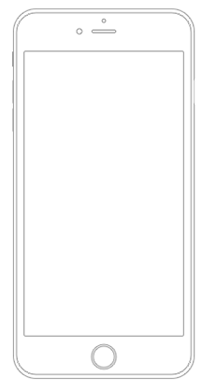



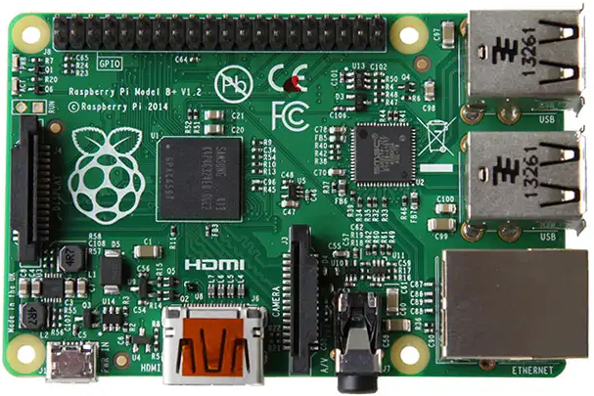
Objective: Tkinter notification triggered.

Slide 3
Overview of Main Steps
Set up MQTT (Adafruit IO)
Set up IFTTT
Confirm RPi can poll MQTT server, get command from IFTTT
Make simple tkinter program that displays a dialog when triggered
Done!

Slide 4

Information and Caveats
Sources
github.com/knud/HackEDbeta2022Workshop
io.adafuit.com - MQTT
ifttt.com – If This Then That (IFTTT)

Slide 5

Information and Cavets
Should work at home. Some necessary networking protocols are blocked in places like the U of A
Zero-conf
Multicast DNS (mDNS)

Slide 6


MQTT — mqtt.org
An extremely lightweight publish/subscribe messaging transport to support machine-to-machine (M2M), Internet of Things (IoT) interactions.
Small; Windows executable is 1.4 MB
https://en.wikipedia.org/wiki/MQTT
Specification is found at mqtt.org

Slide 7
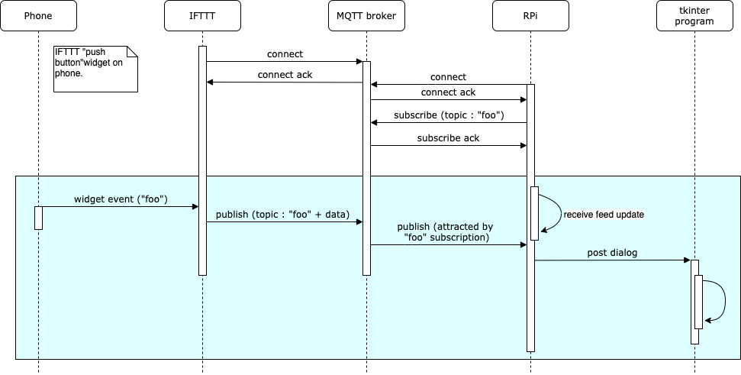
Notes:
IFTTT supports building little apps or applets that will connect your phone or computer to other IoT things.
MQTT is a light-weight publish-subscribe protocol used to connect devices over a network, and most commonly used for IoT applications. We can think of a client server relationship for MQTT-enabled things.

Slide 8
Client
Server
Notes:
The IFTTT service connects to the MQTT broker aka server and will push events to it.

Slide 9
Client
Server
Client
Notes:
The RPi also connects to the MQTT broker and subscribes for events that match what the IFTTT client might push.
If the RPi gets an event it’s looking for, it can do something, like turn on a switch, make a measurement, or in our case display a dialogue

Slide 10
Set up MQTT
Sign up with io.adafruit.com (aka AIO)
Create new dashboard and open
Create a new feed and block
Set up / customize the block
Record AIO key
Needed for IFTTT and RPi client
Update

Slide 11
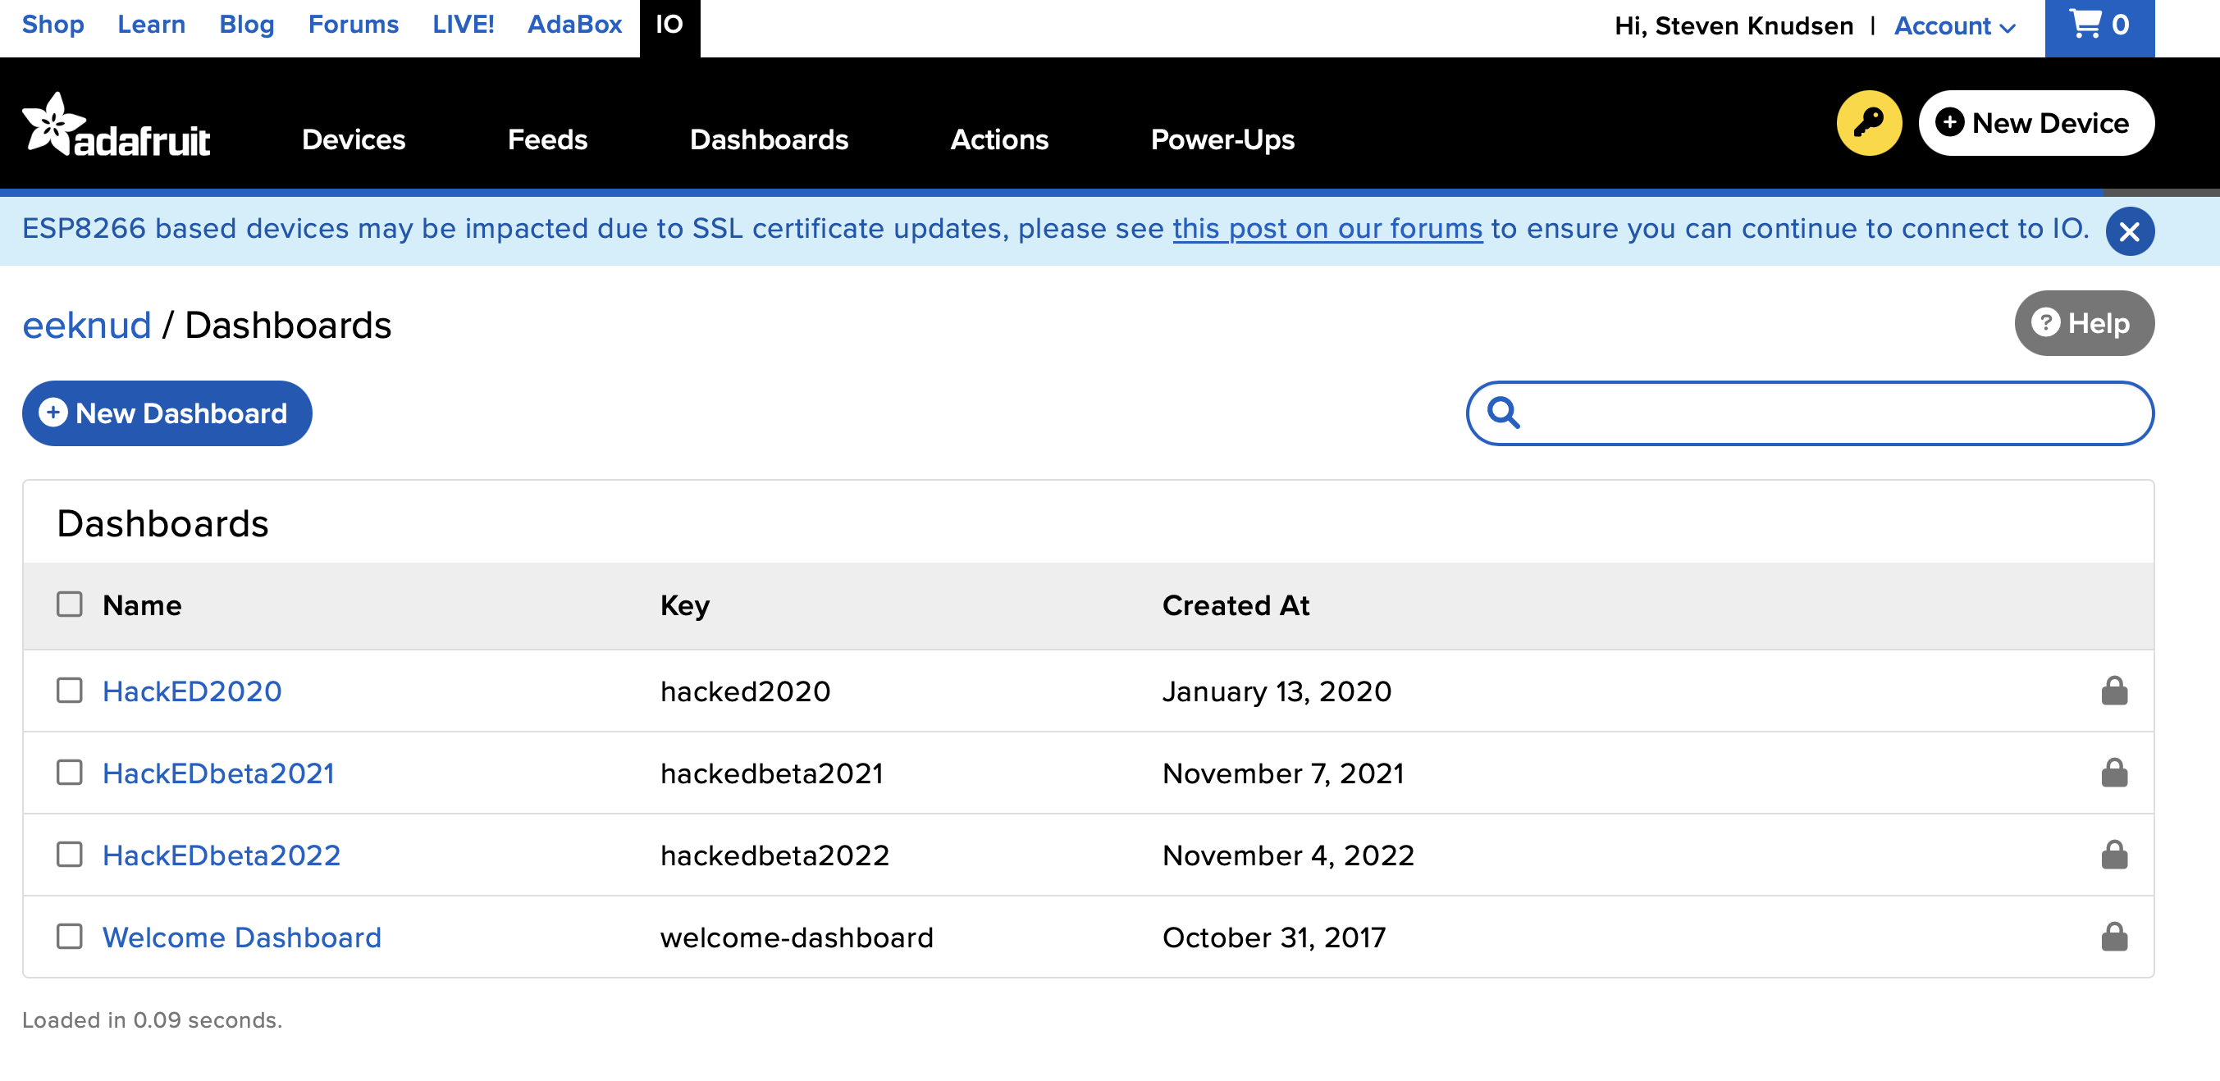
https://io.adafruit.com/eeknud/dashboards
Notes:
After we have signed up for an Adafruit account, go to io.adafruit.com Make a new dashboard.

Slide 12
https://io.adafruit.com/eeknud/dashboards
Notes:
After we have signed up for an Adafruit account, go to io.adafruit.com Make a new dashboard.

Slide 13
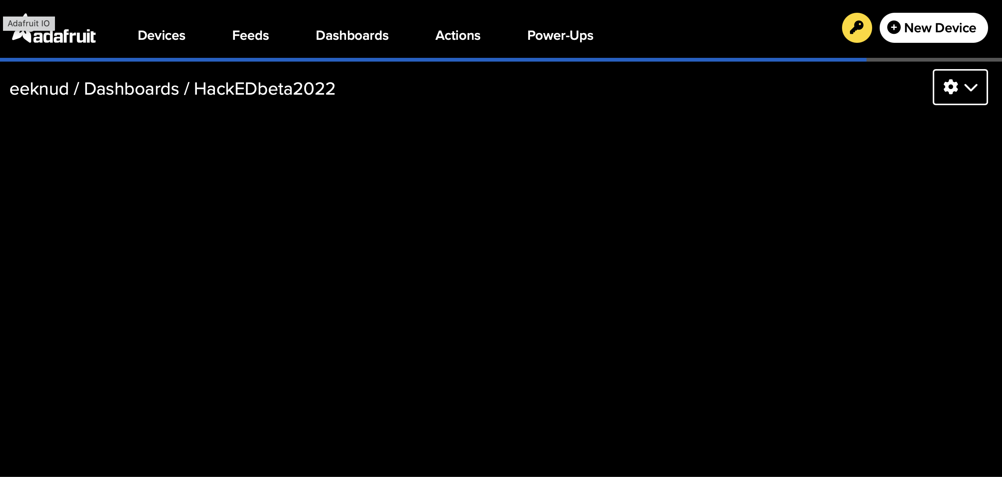
Notes:
Our dashboard is empty,

Slide 14
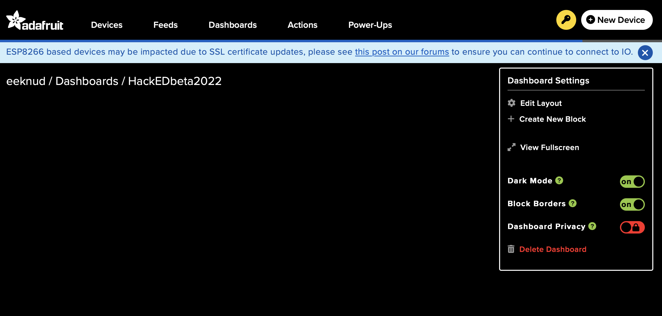
Notes:
This menu is where we start.

Slide 15
Notes:
Click Create New Block

Slide 16
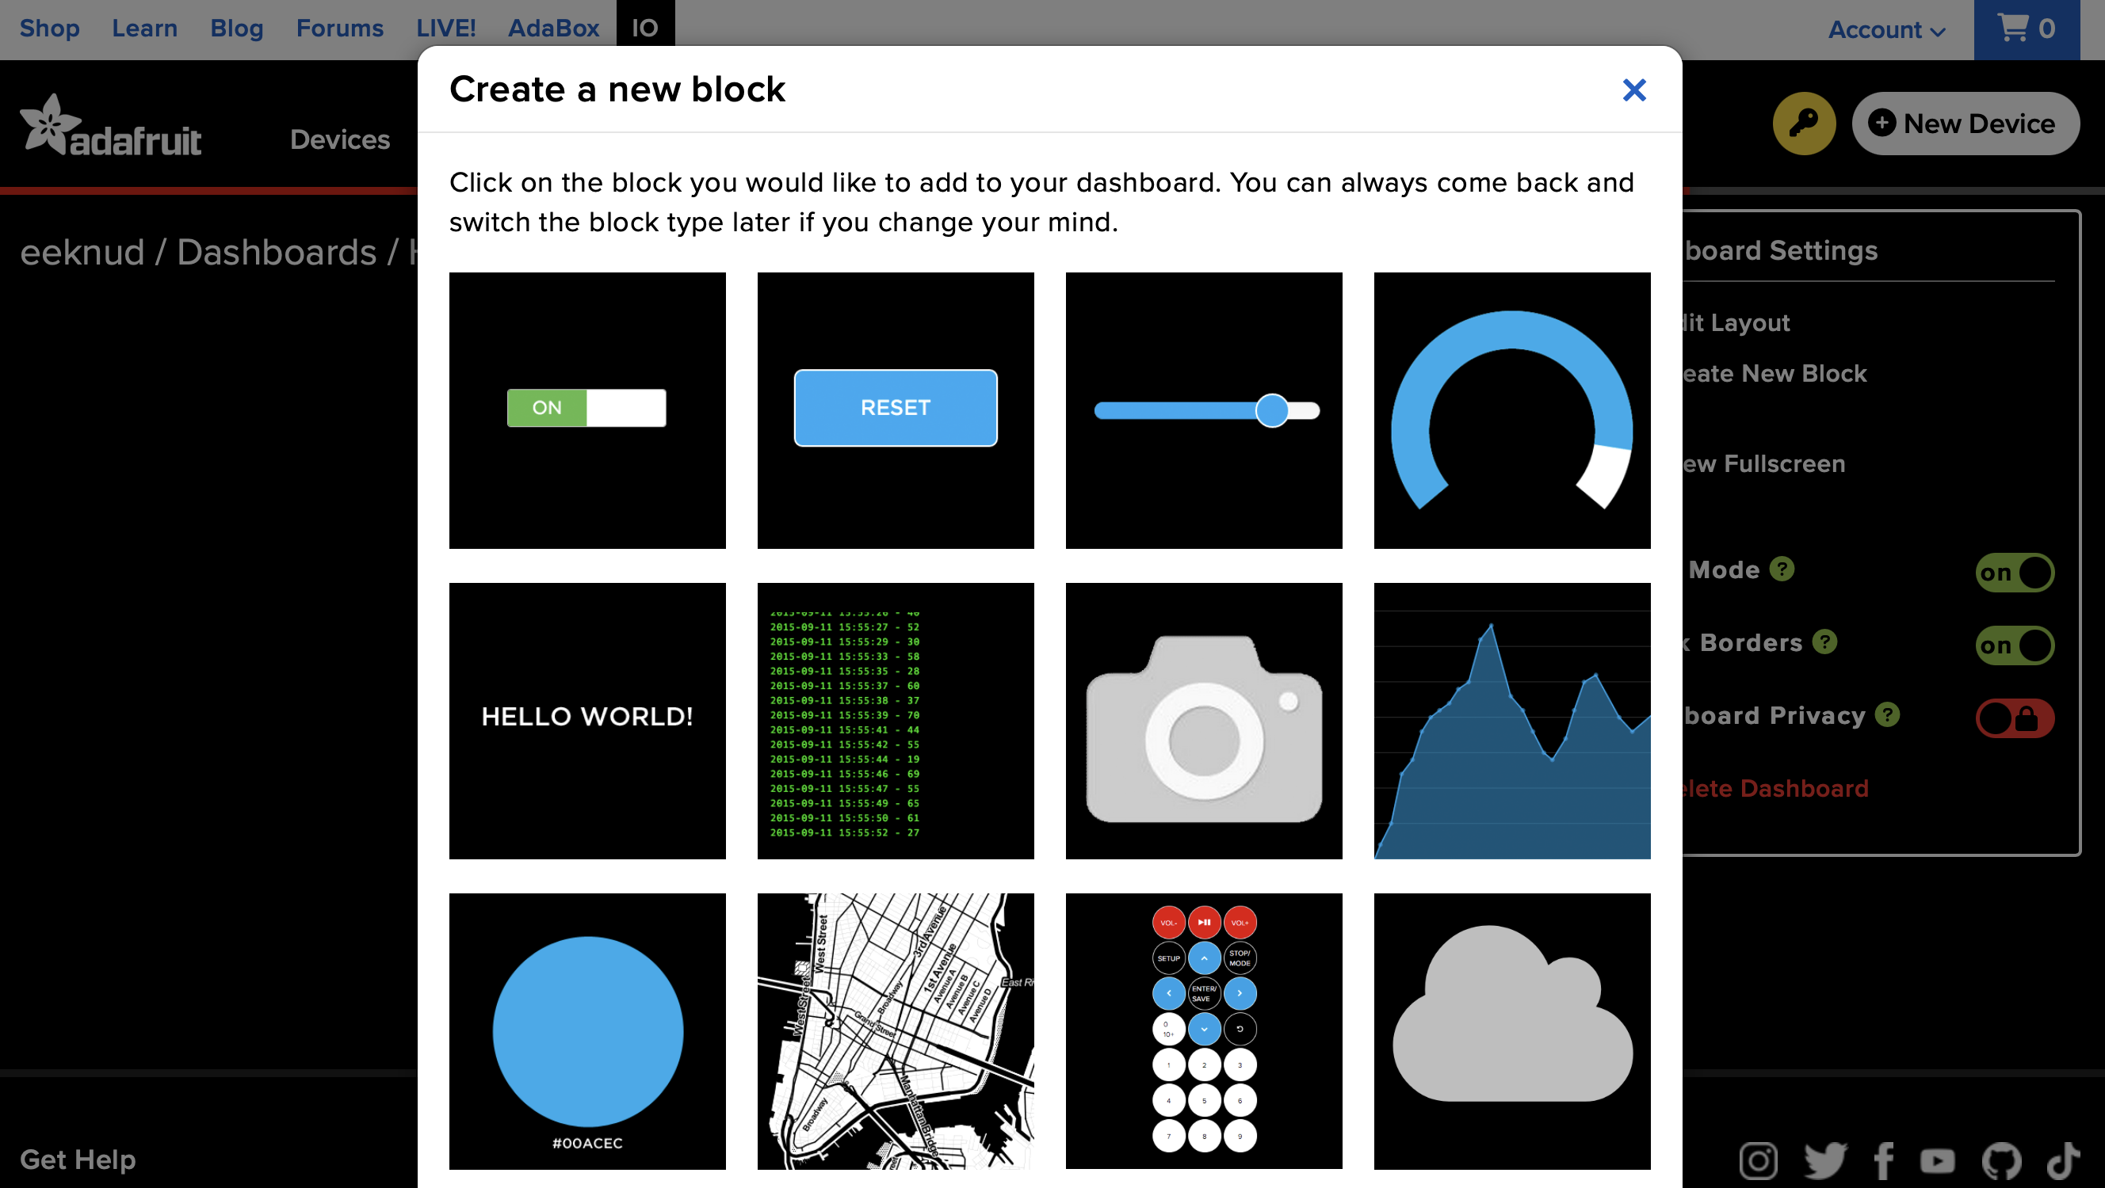

Slide 17

Notes:
Hovering over the switch indicates it’s a toggle switch

Slide 18
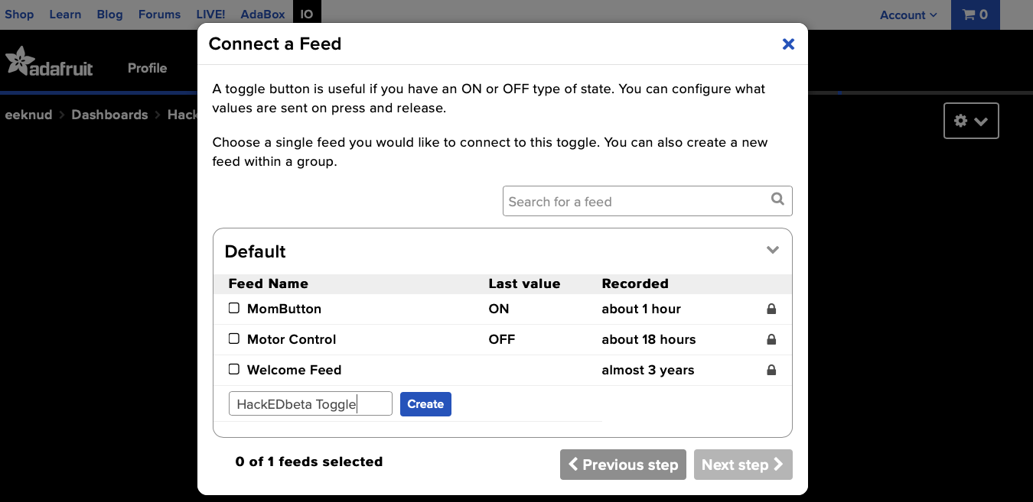
Notes:
Let’s give our feed a good name and create

Slide 19
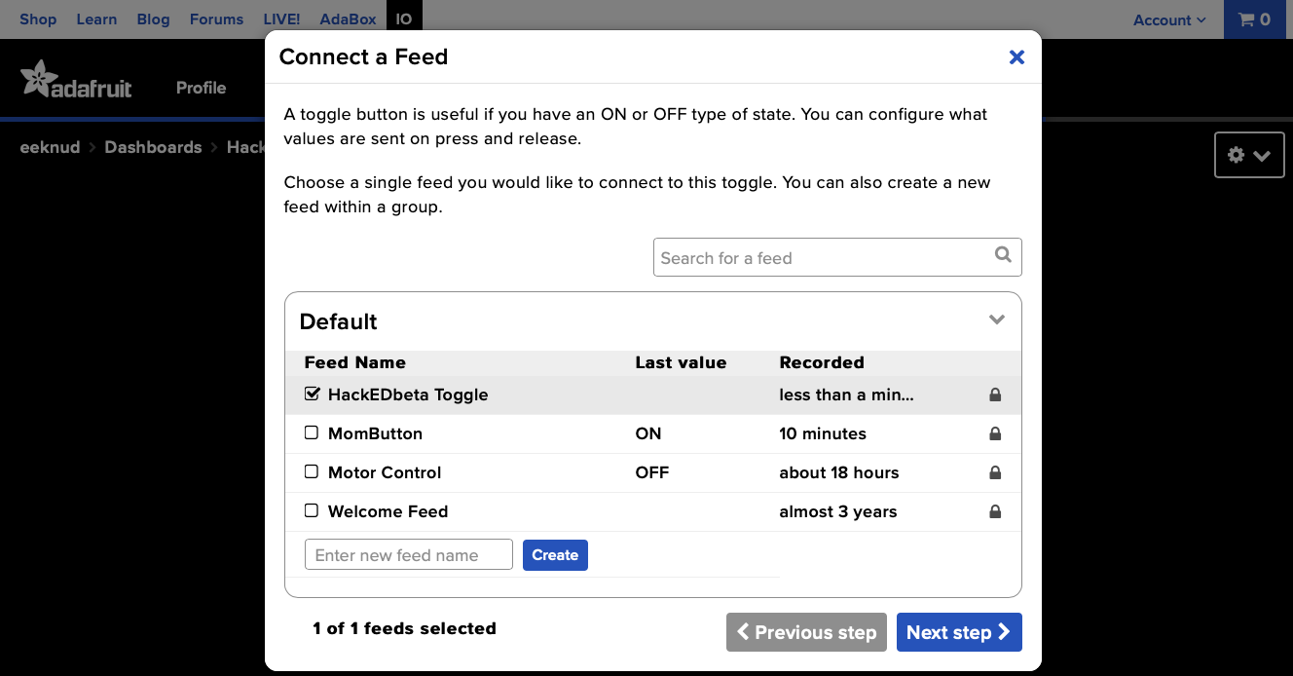
Notes:
Select the feed and go to next step

Slide 20
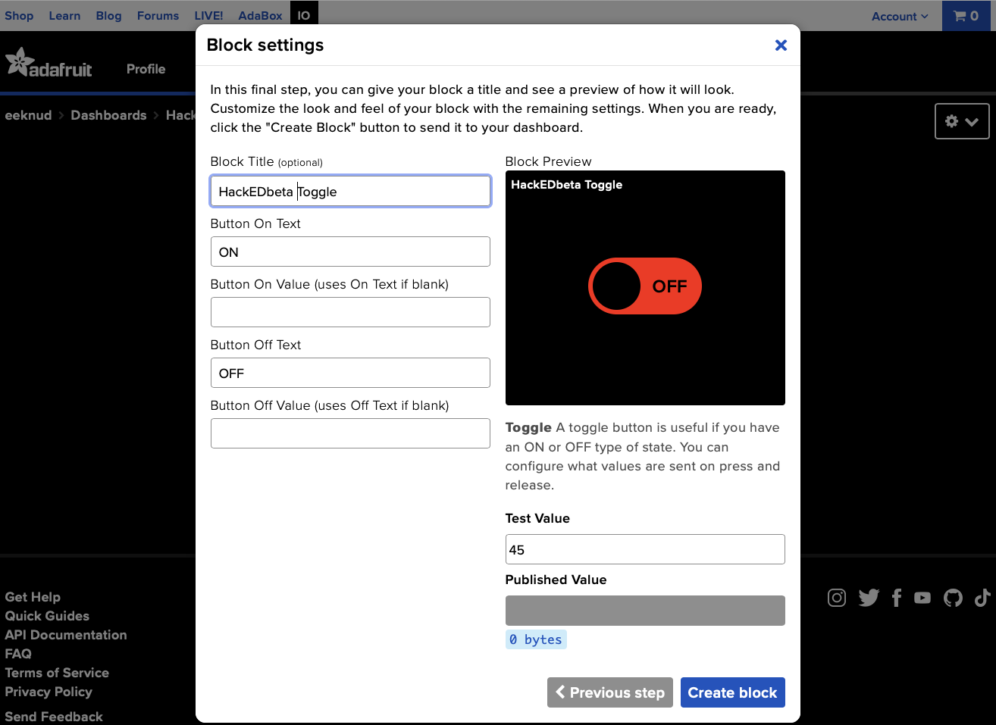
Notes:
We give our toggle switch a nice name. Can leave the rest as is.
We expect to receive a value of either ON or OFF depending on the toggle’s state.

Slide 21
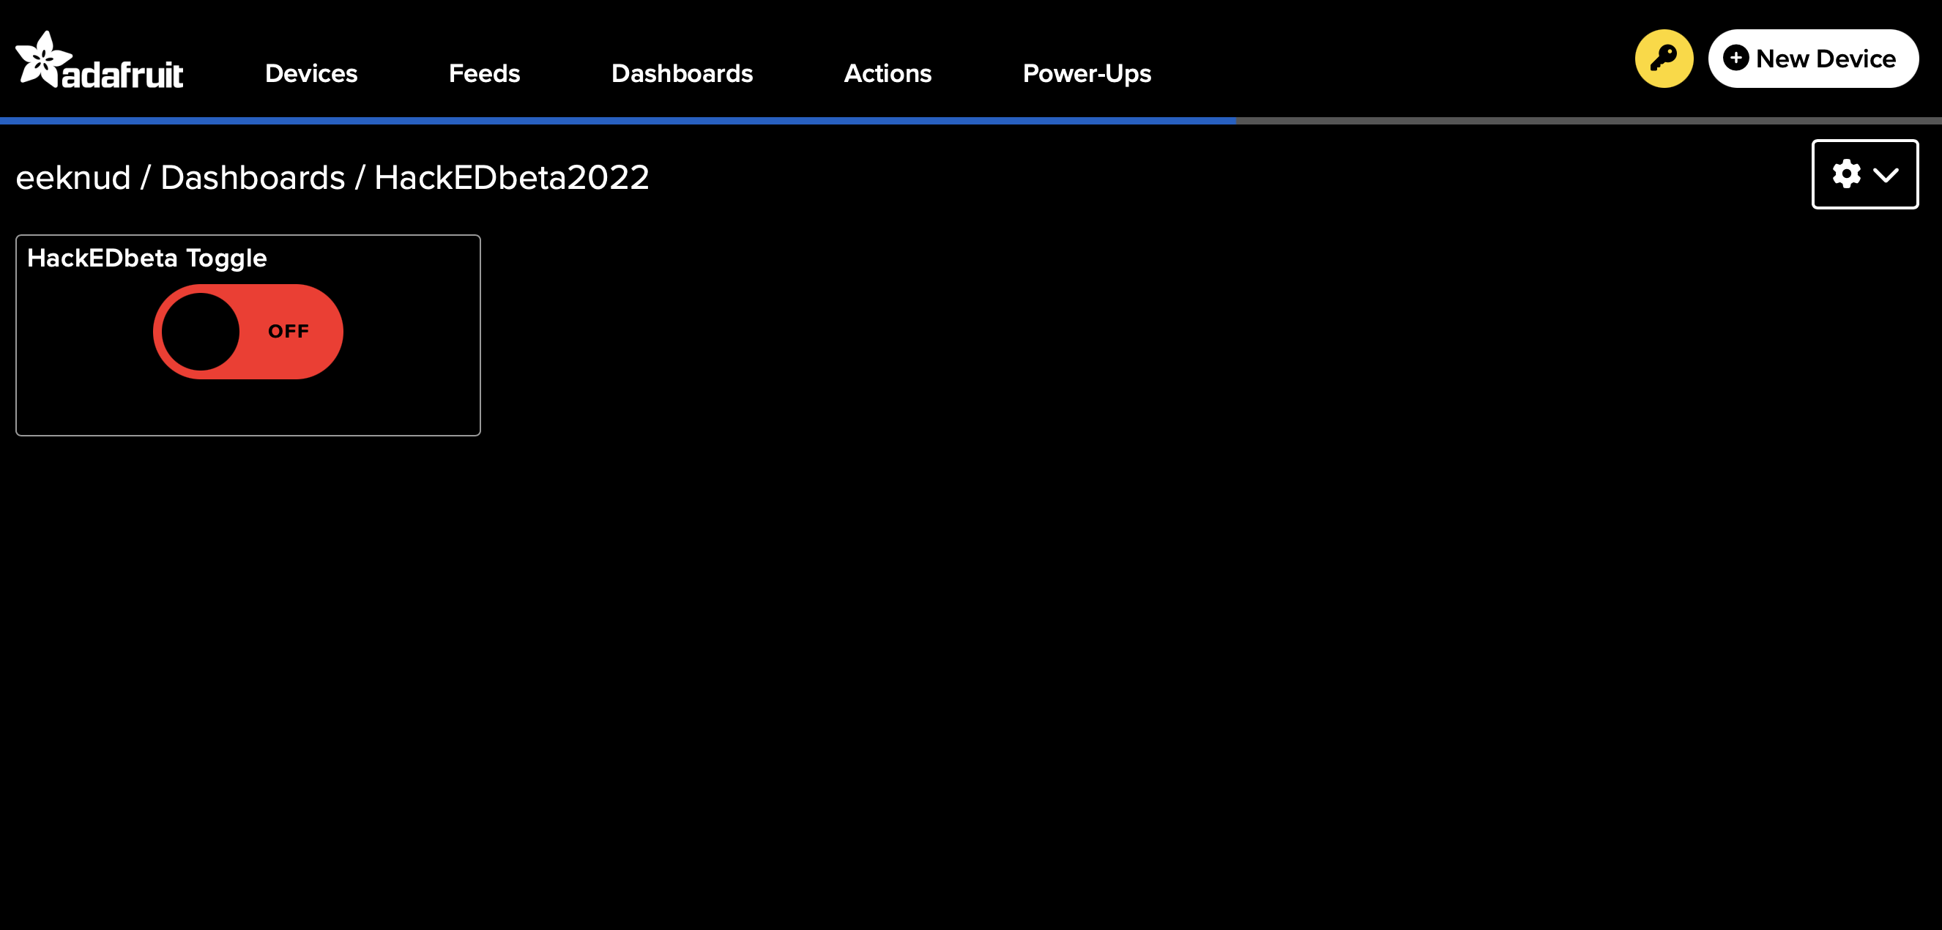
Notes:
This is what our button looks like.
Next we need some key information that we use later as part of our Raspberry Pi program
Click My Key

Slide 22
Notes:
Click the Key

Slide 23
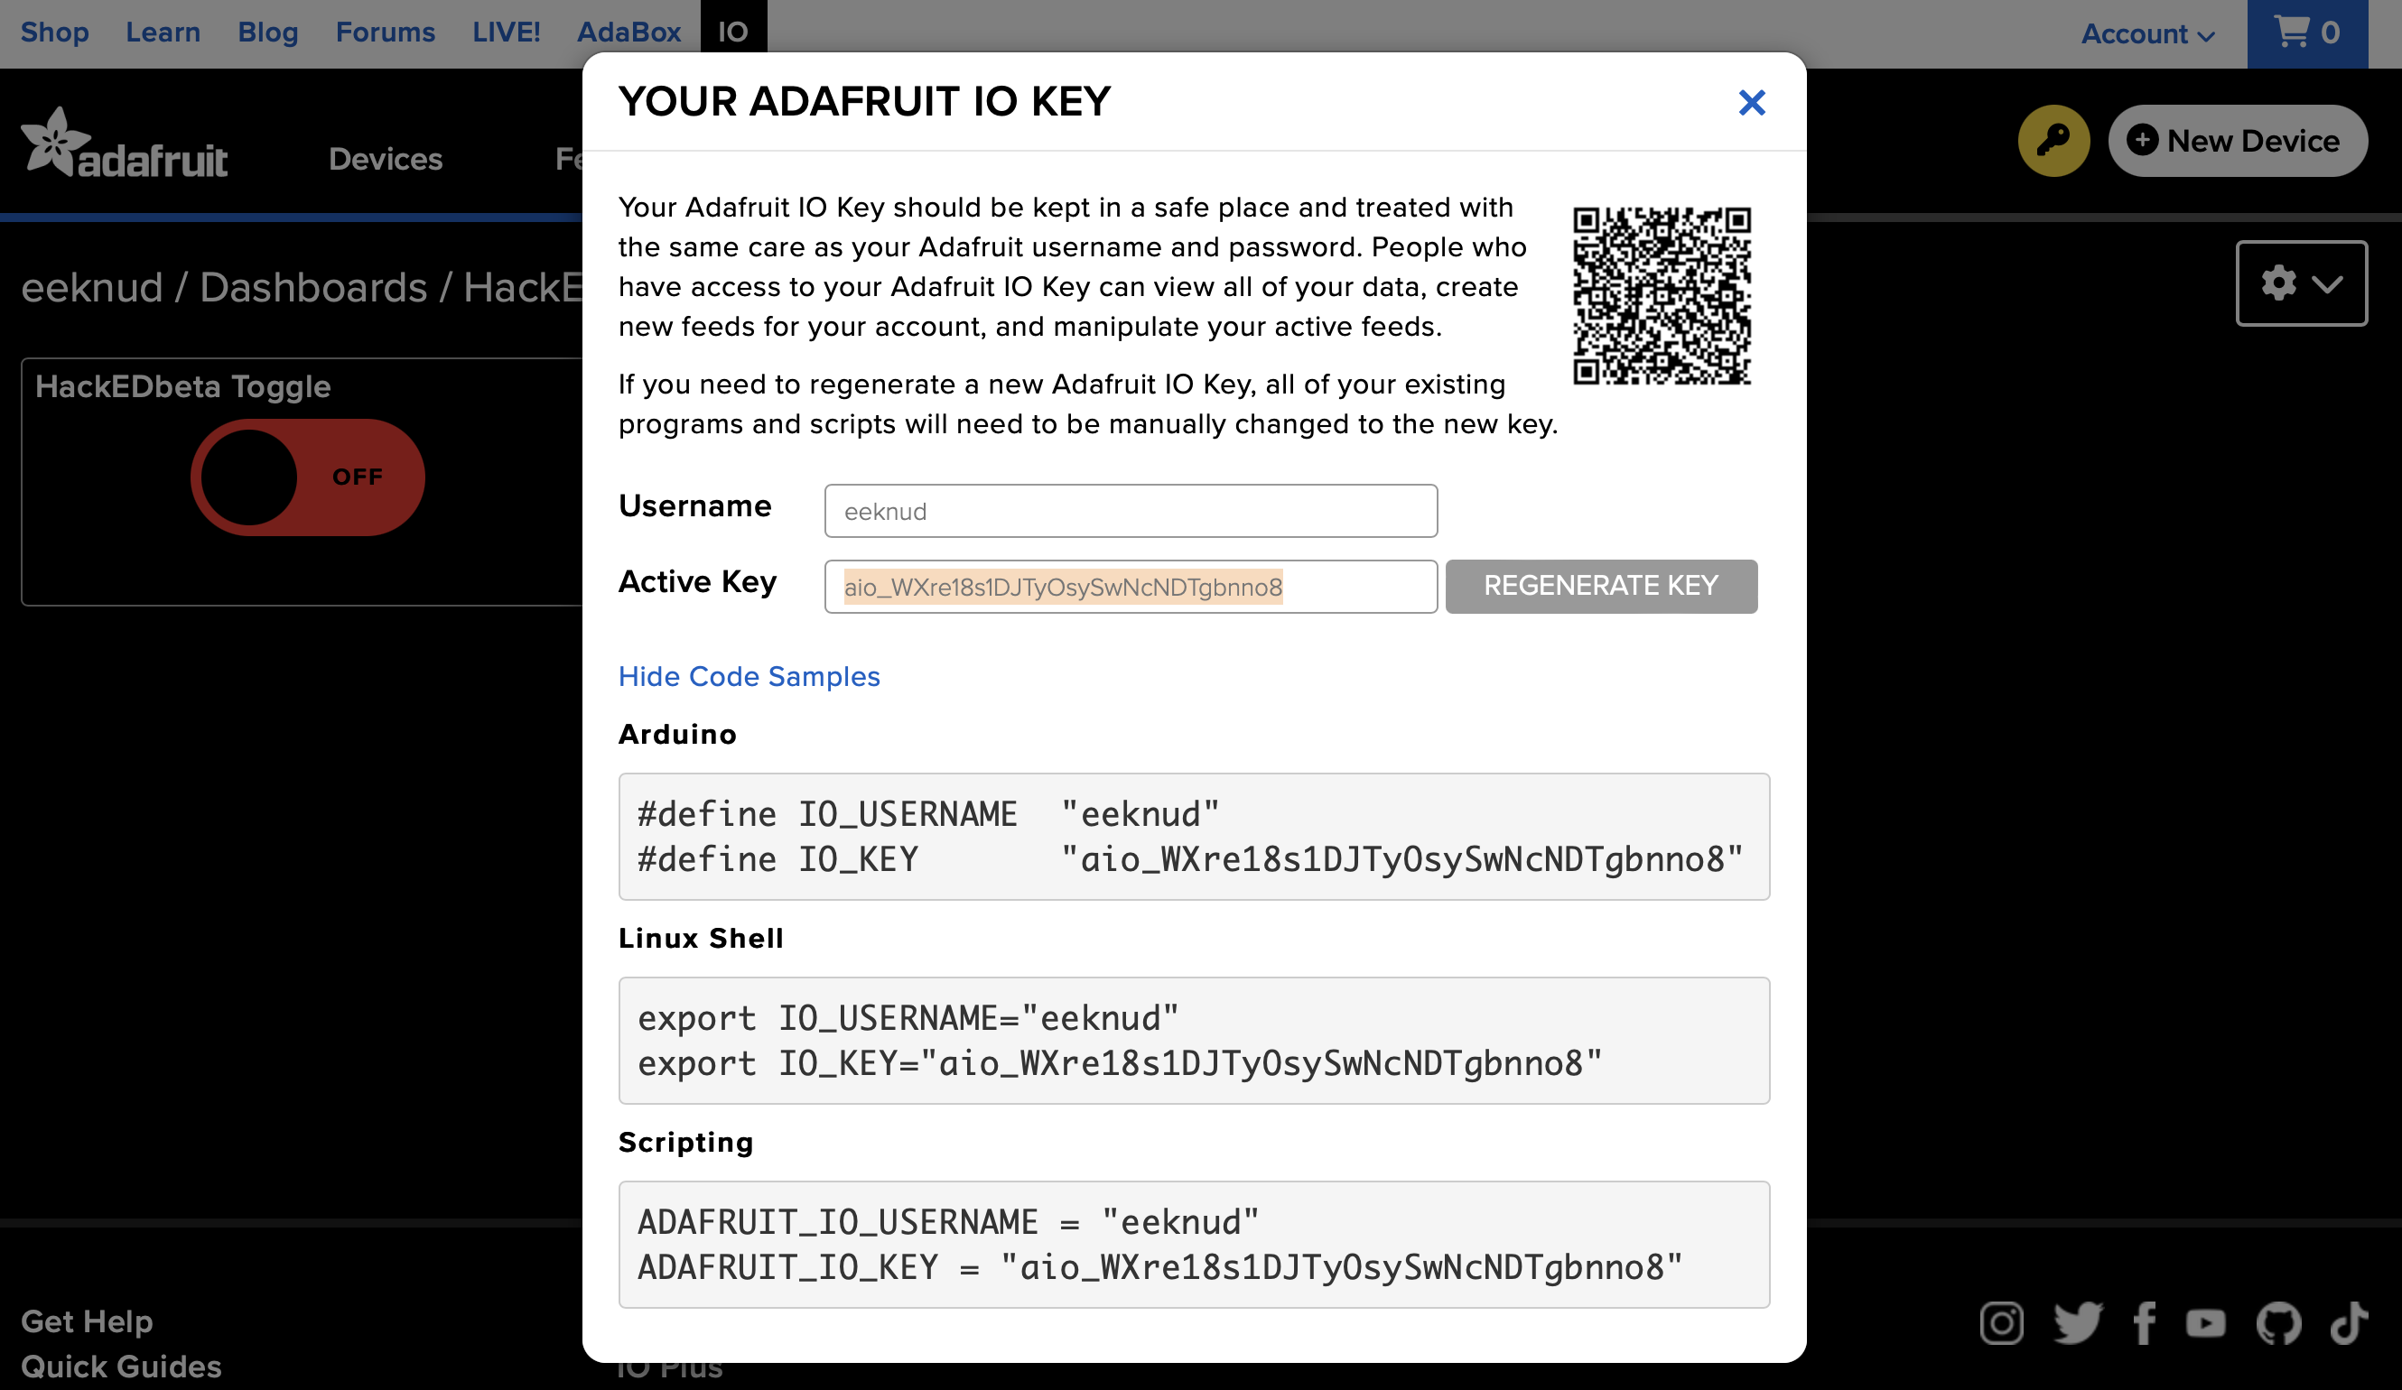
Notes:
We are going to want the username and key information, but are going to use it in a Python program, so it will be declared a little differently.

Slide 24
Notes:
Save a copy of this info in a text file.

Slide 25
Next, set up IFTTT
Create a new widget
Select an action (“This”)
Button
Select a service (“That”)
Choose Adafruit service
We’ll make one button to toggle something ON, and another to toggle it OFF

Slide 26
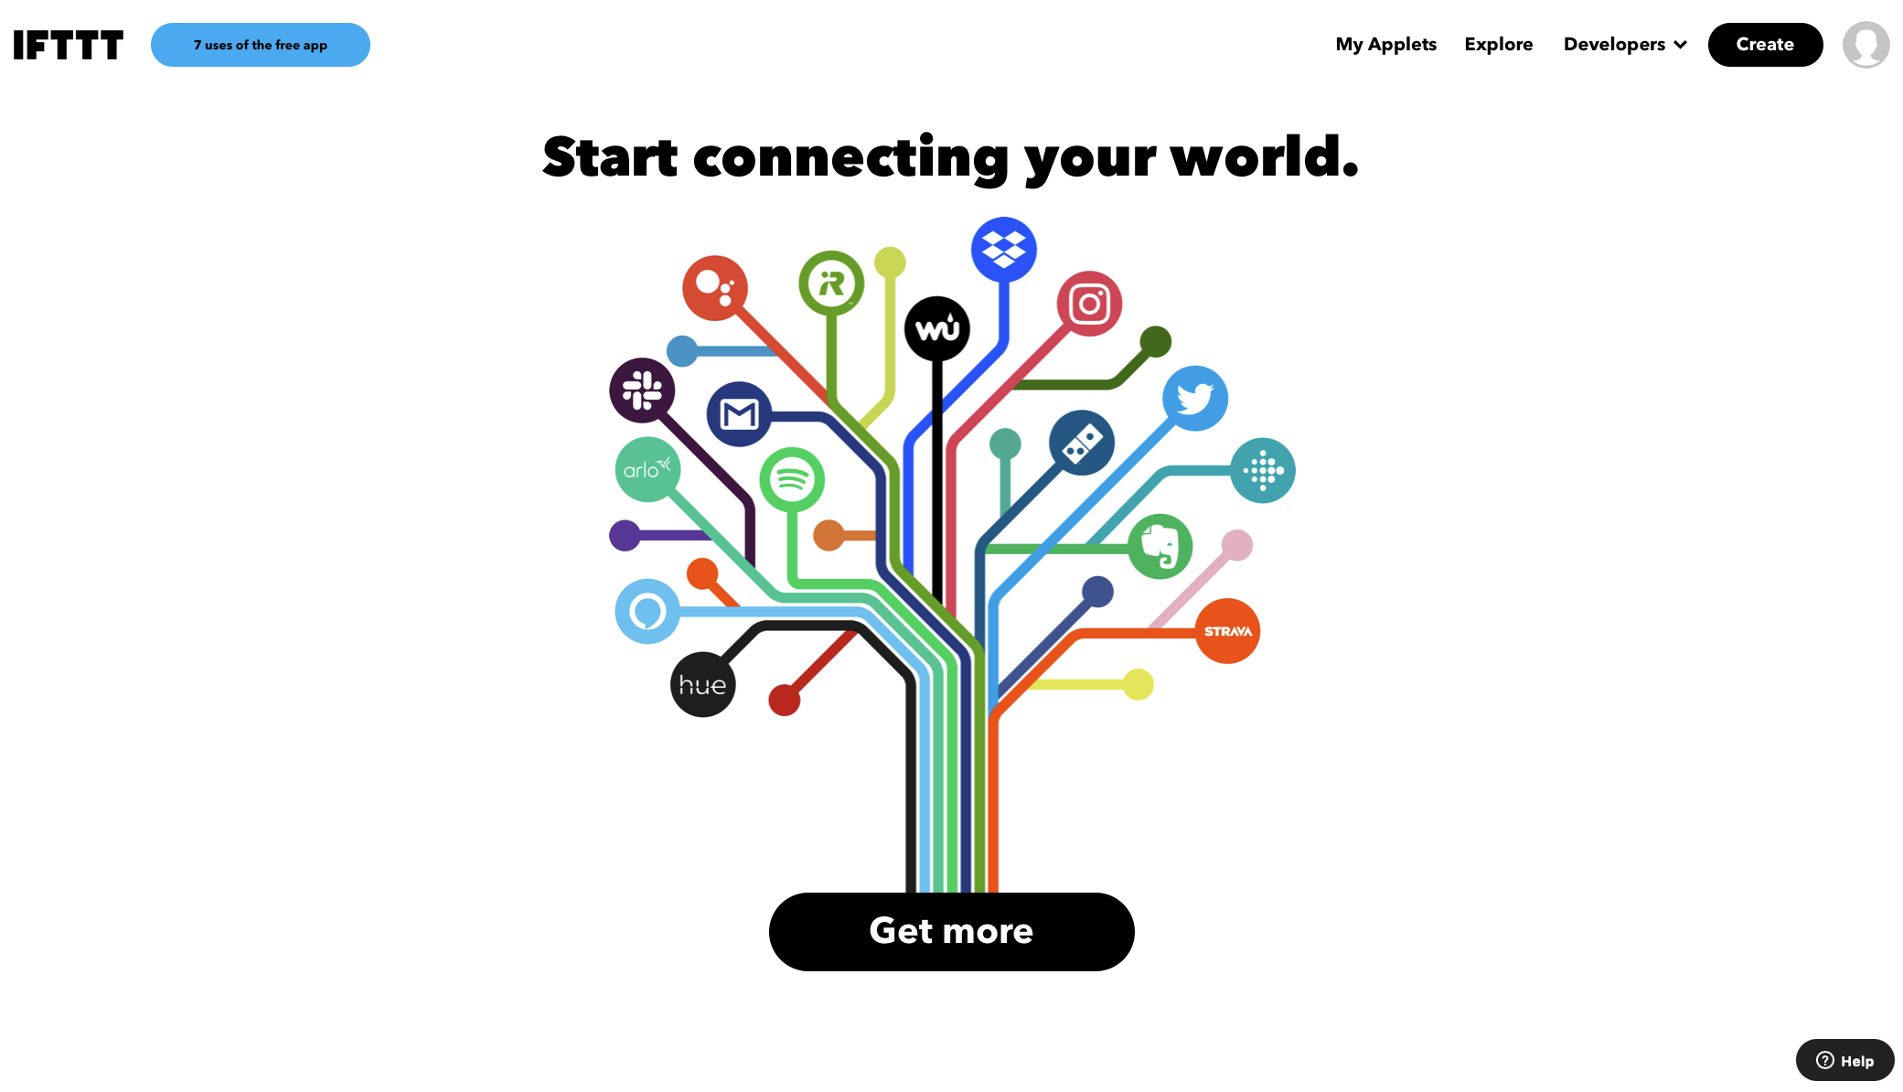
Notes:
When you create an account with IFTTT, you’ll likely see a page like this, which is where we create our first widget
Click Create

Slide 27
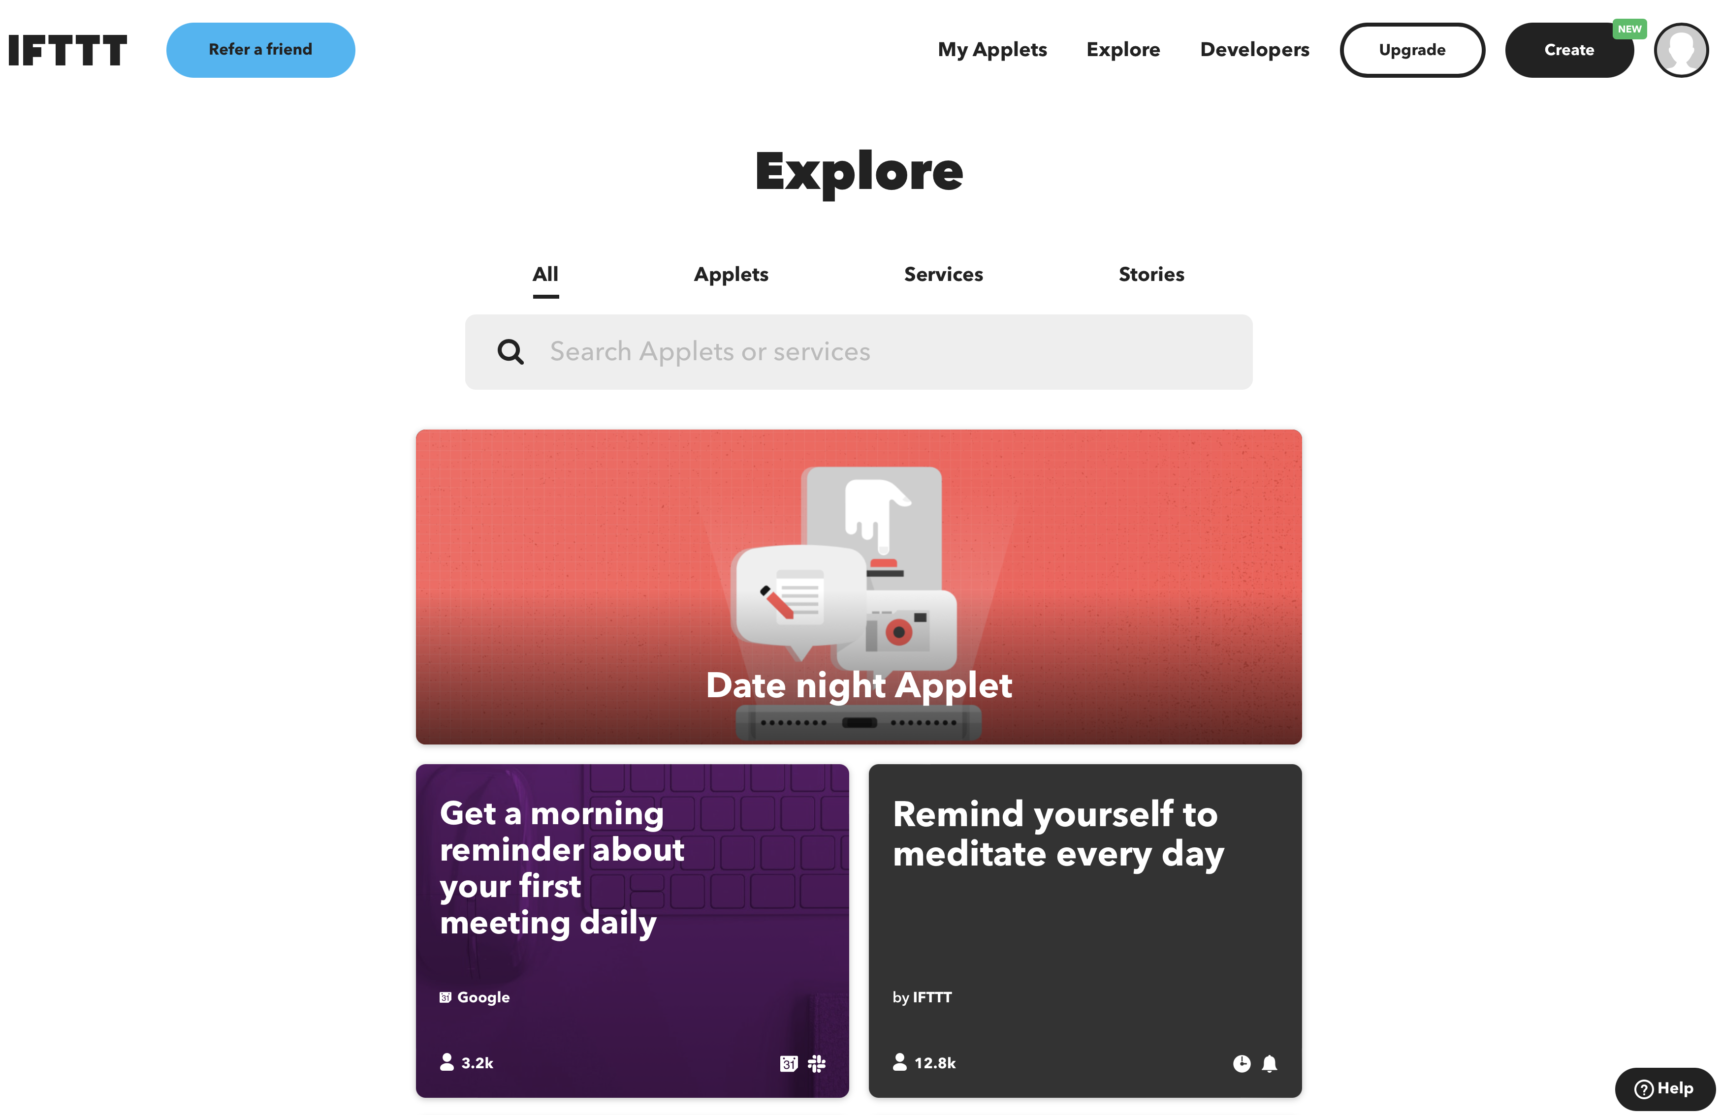
Notes:
I decided I needed more from the service, so have paid plan and my start page looks like this.
The point is that we need to create a new IFTTT
Click Create to get started

Slide 28
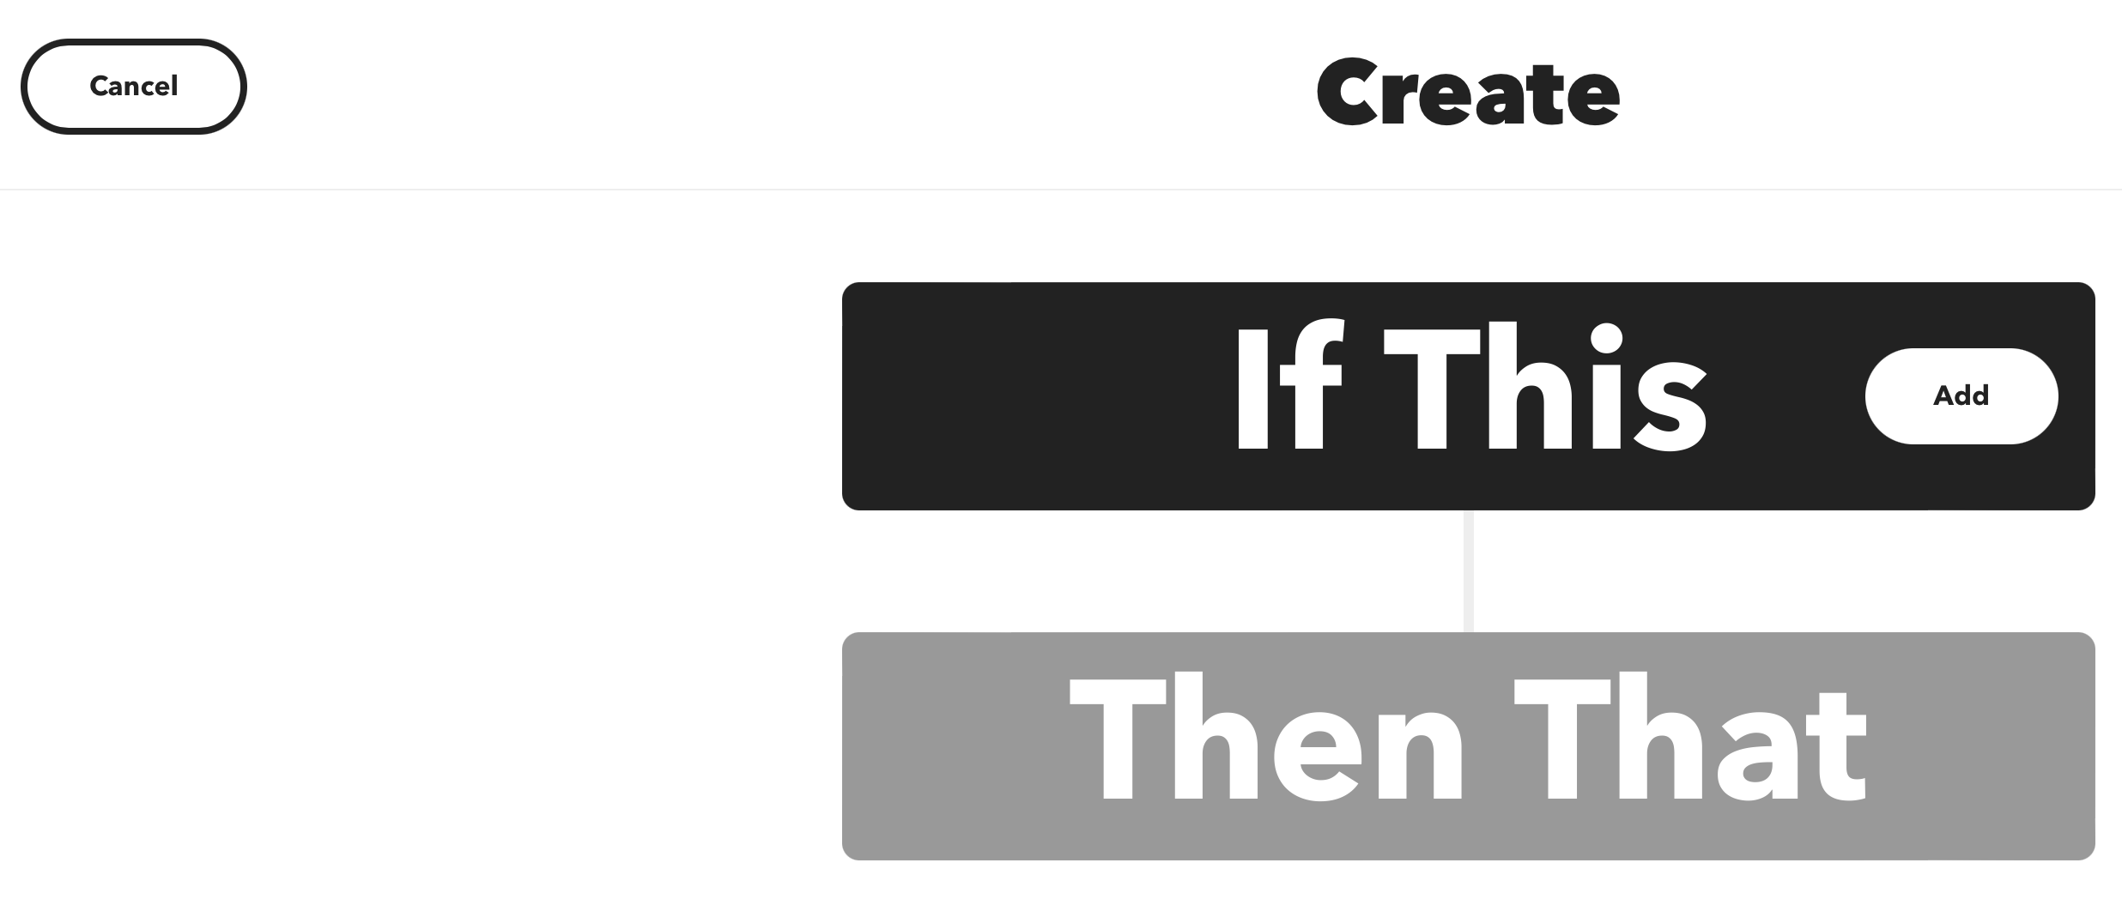

Slide 29
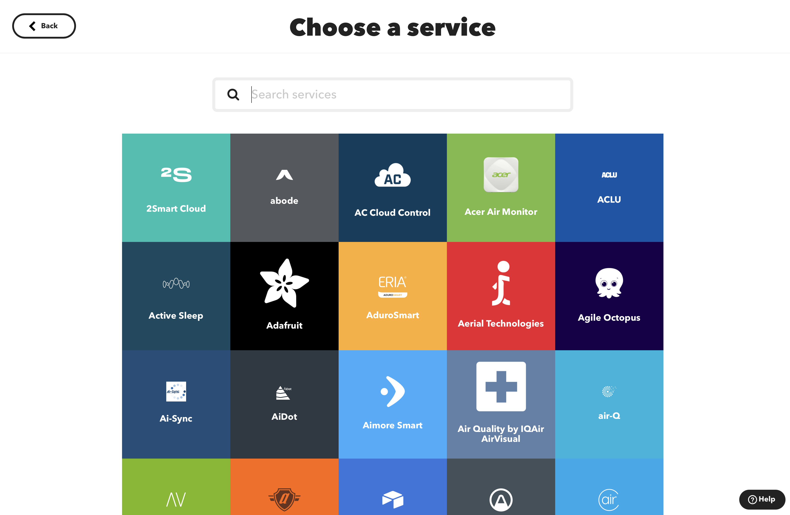
Notes:
We can choose a service
Search for “button”

Slide 30
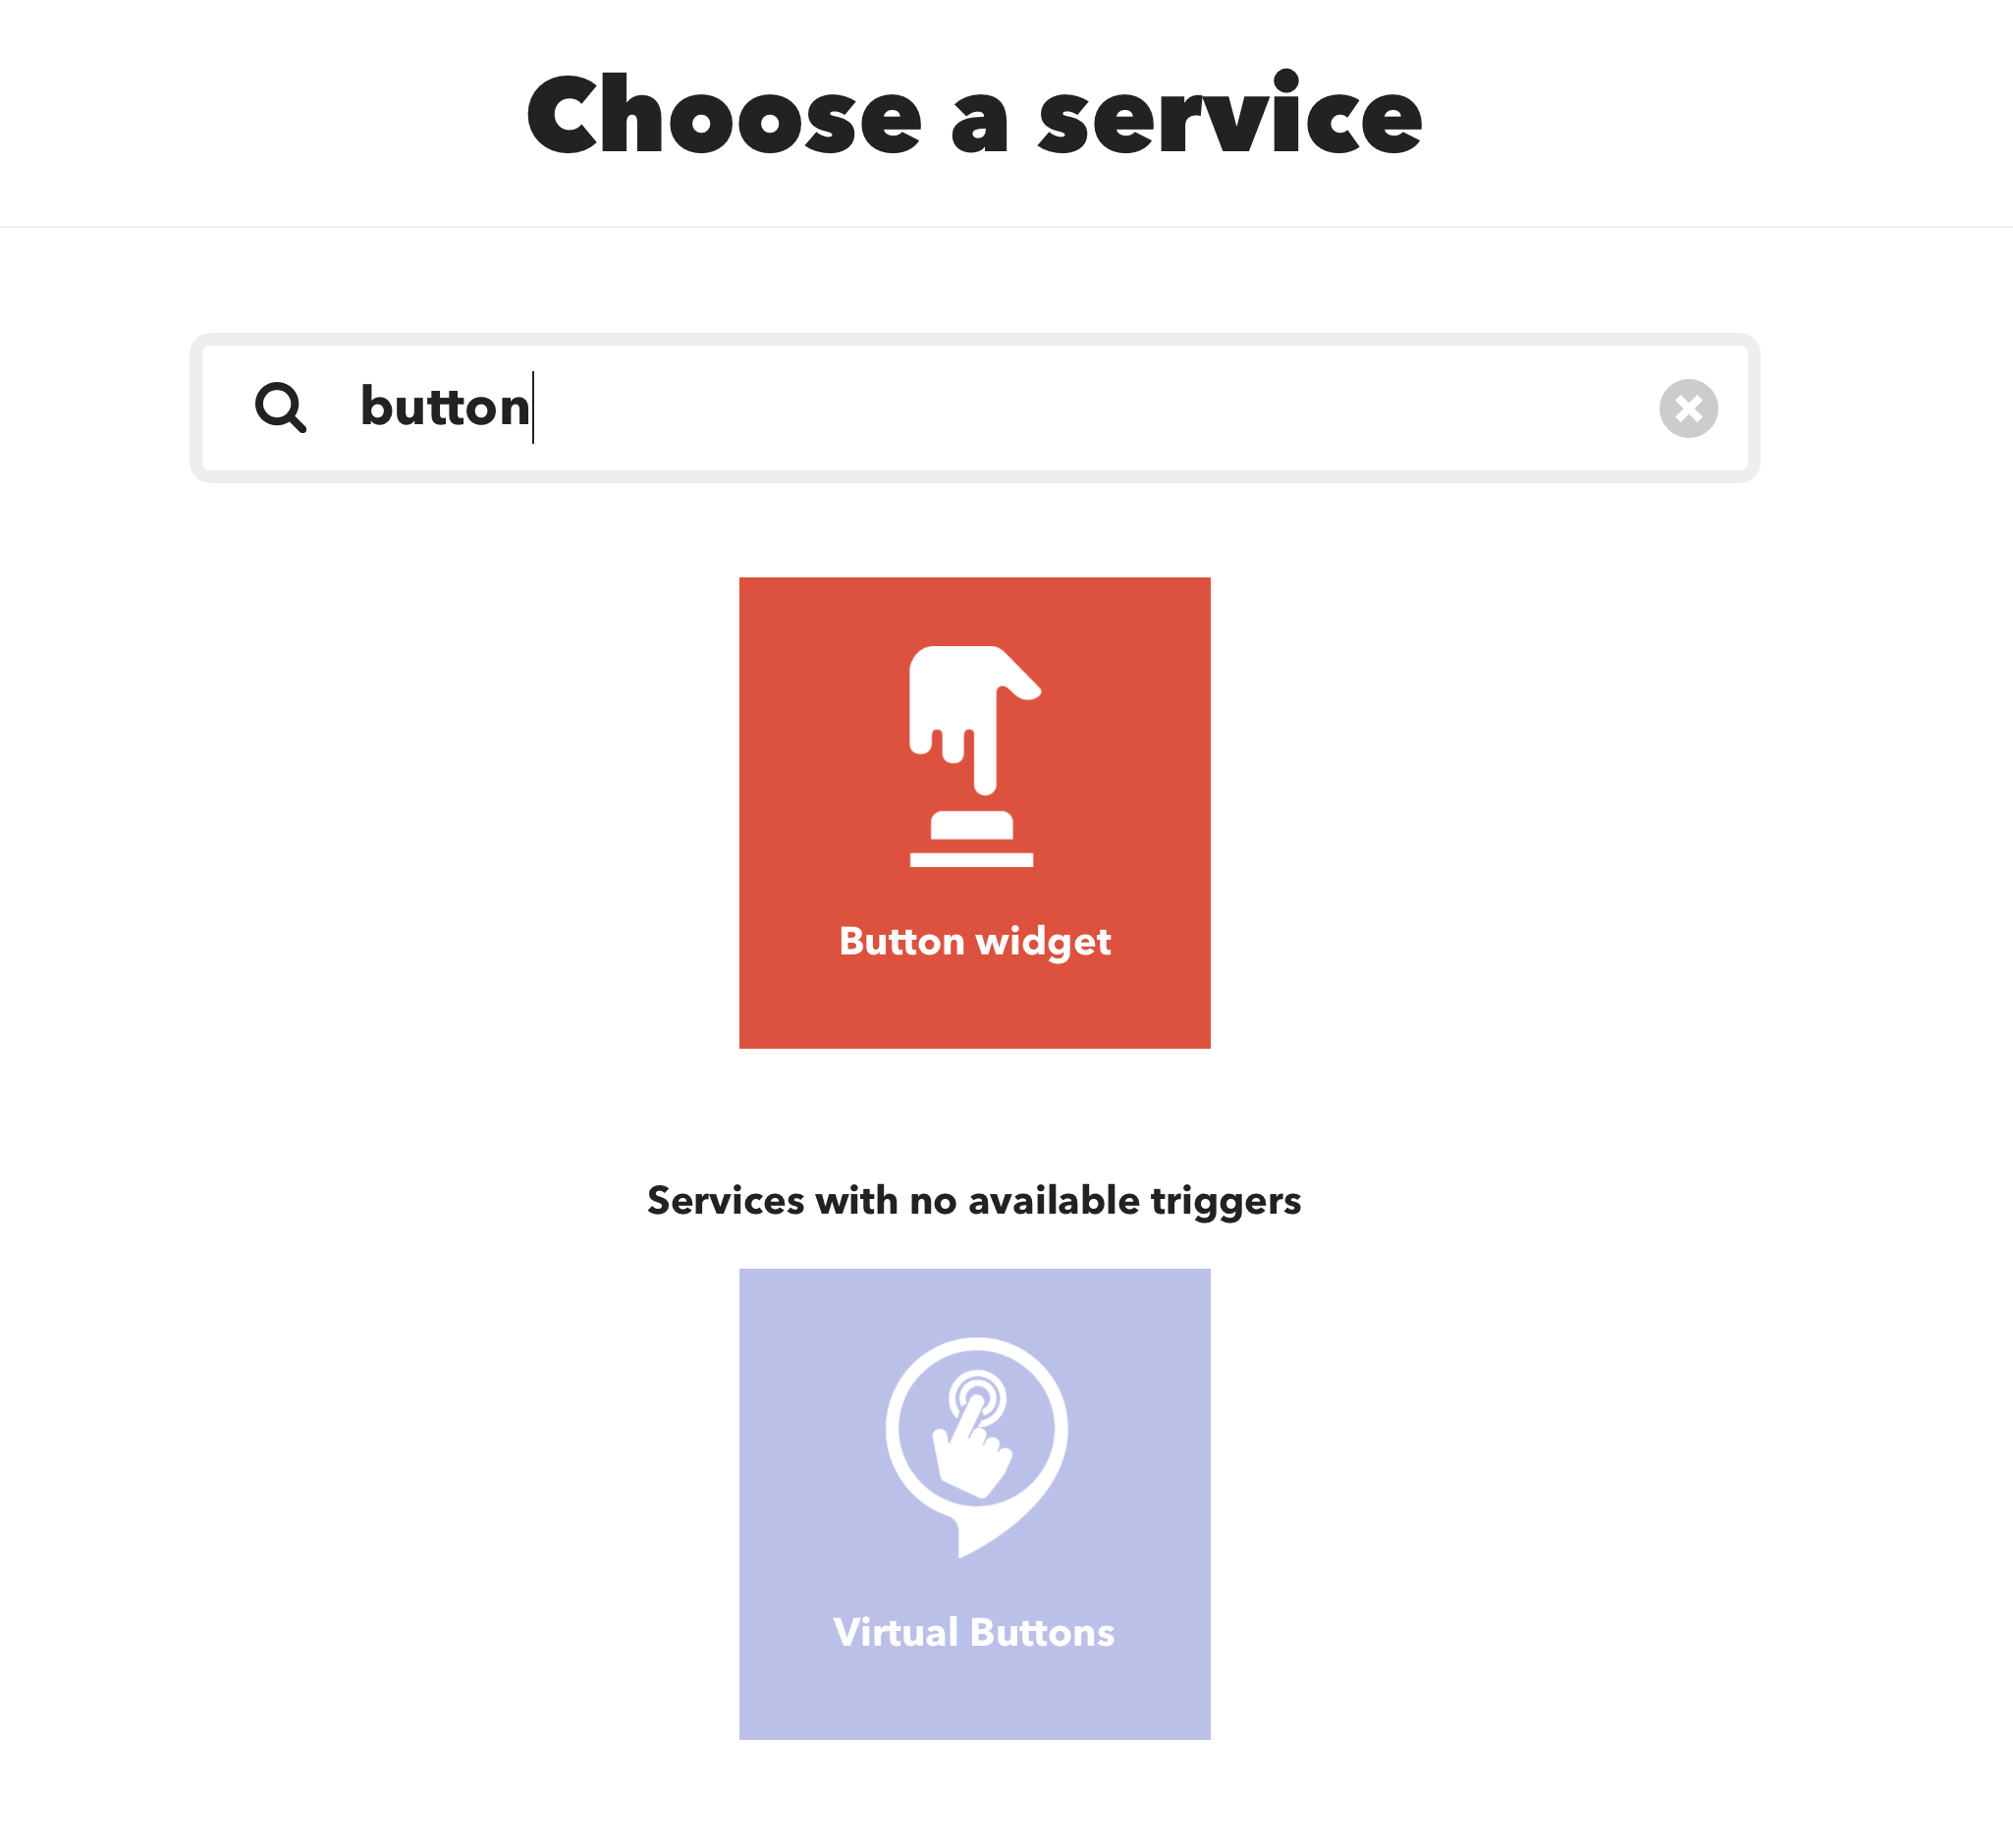
Notes:
Click the button widget

Slide 31
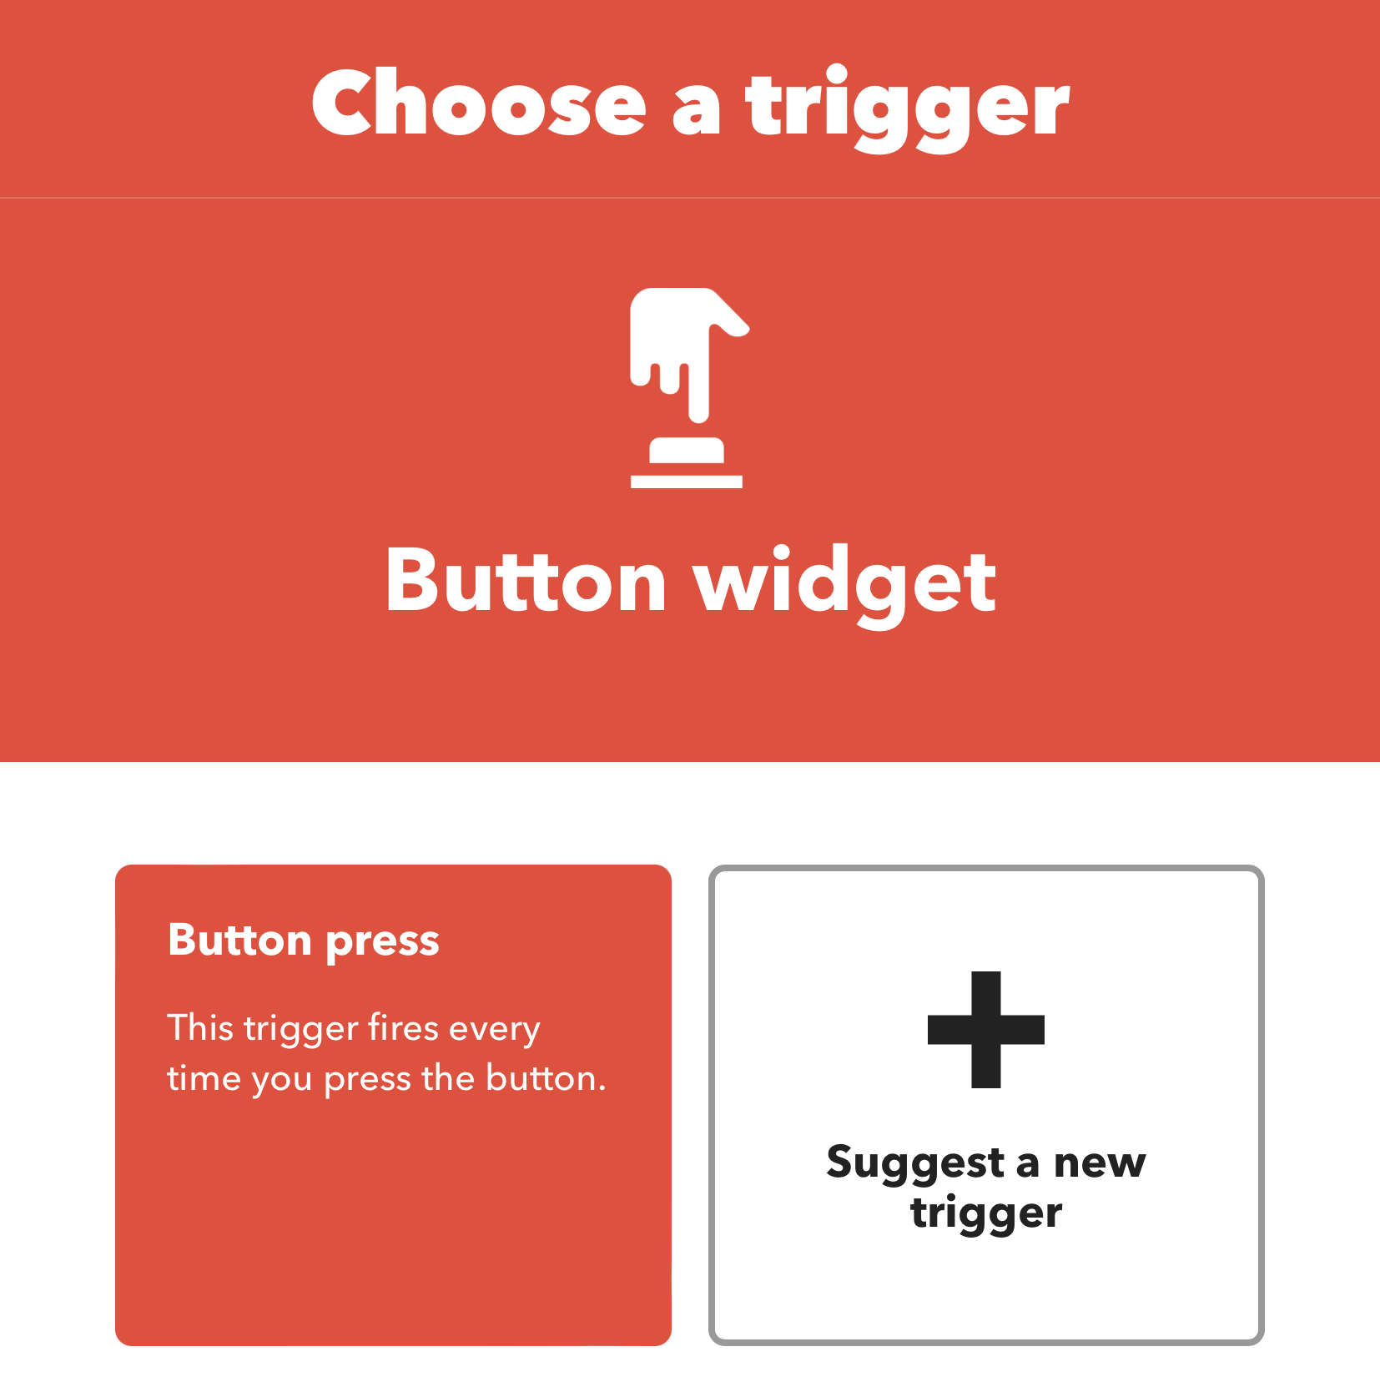
Notes:
Choose the suggested, default trigger

Slide 32
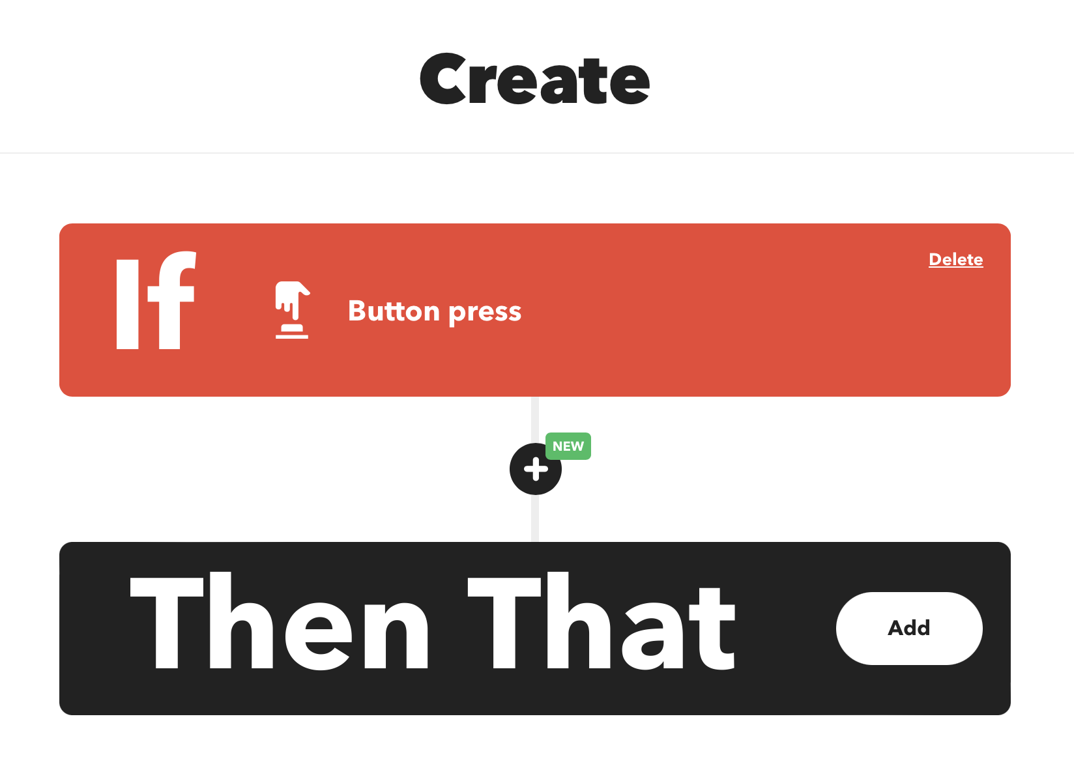
Notes:
Now we add what should happen when the button is pressed
Click Add

Slide 33
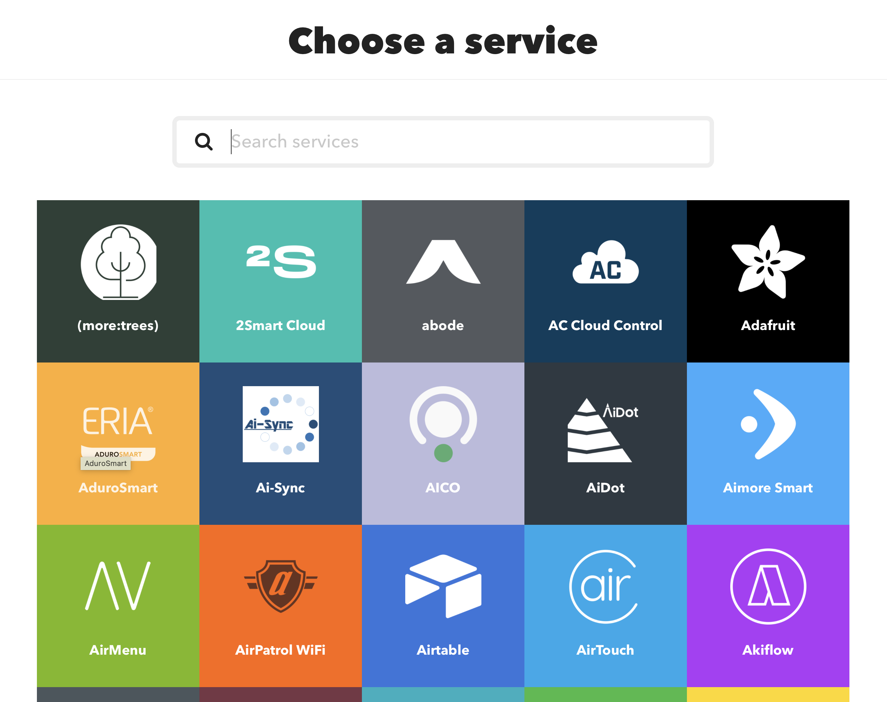
Notes:
There are many services, but it happens that the one we want is near the top.
Choose Adafruit

Slide 34
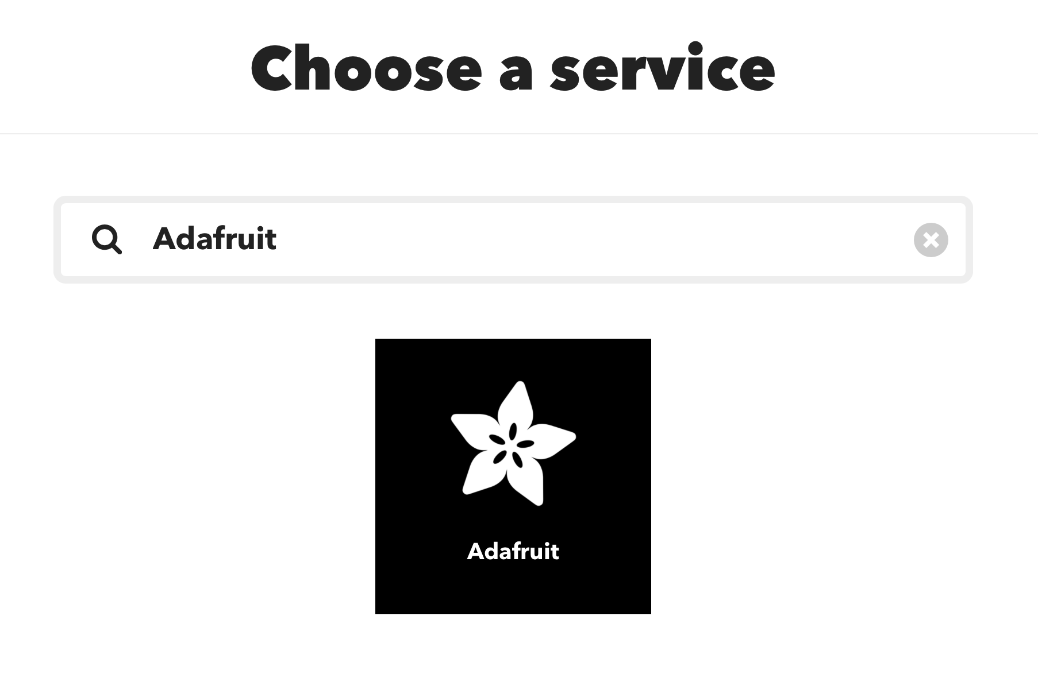
Notes:
The page automatically updates with results as we type, so we see this
Click the icon

Slide 35
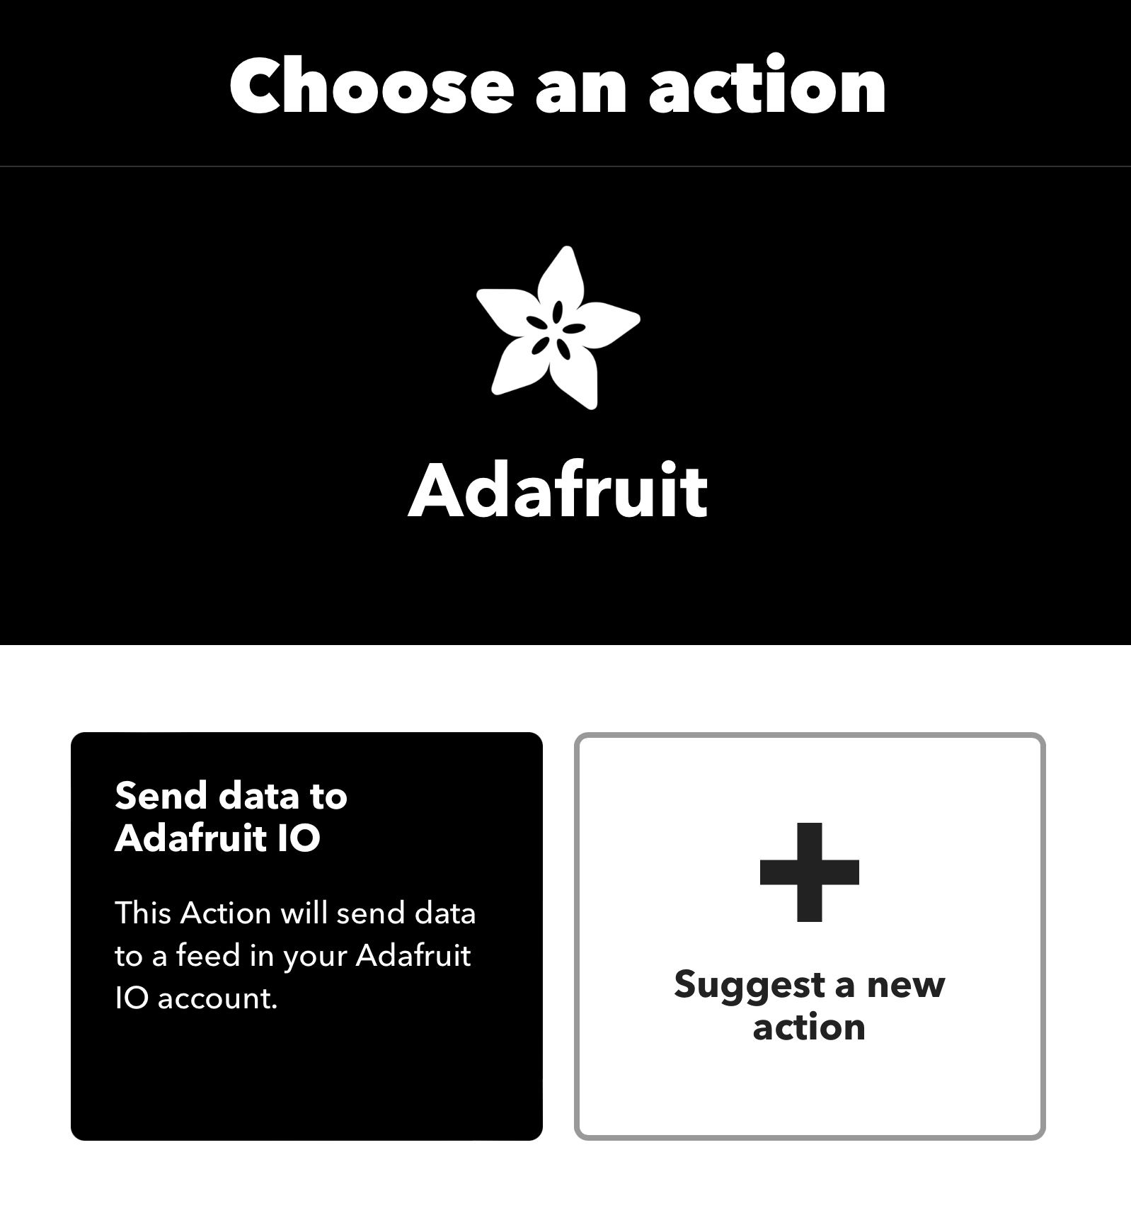
Notes:
Similar to before, we take the default.
Click Send data to Adafruit IO.
In other IFTTT actions there can be more…

Slide 36
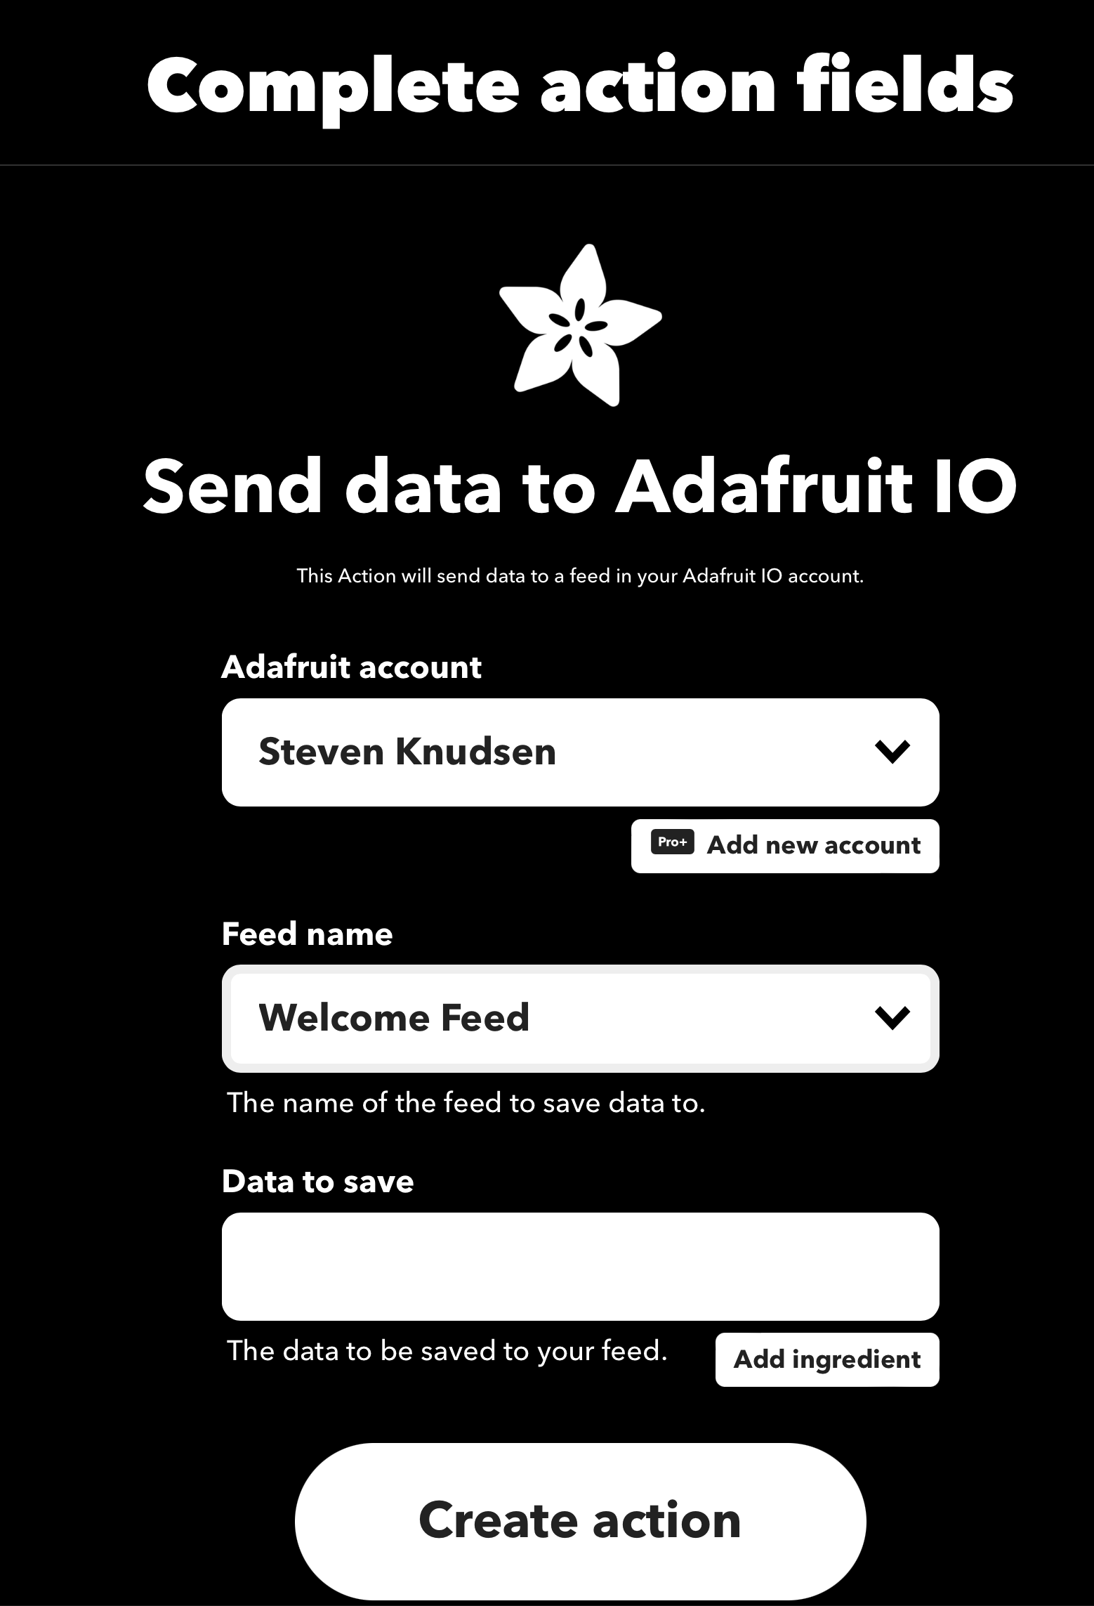
Notes:
We need to set up the action by making some choices…

Slide 37
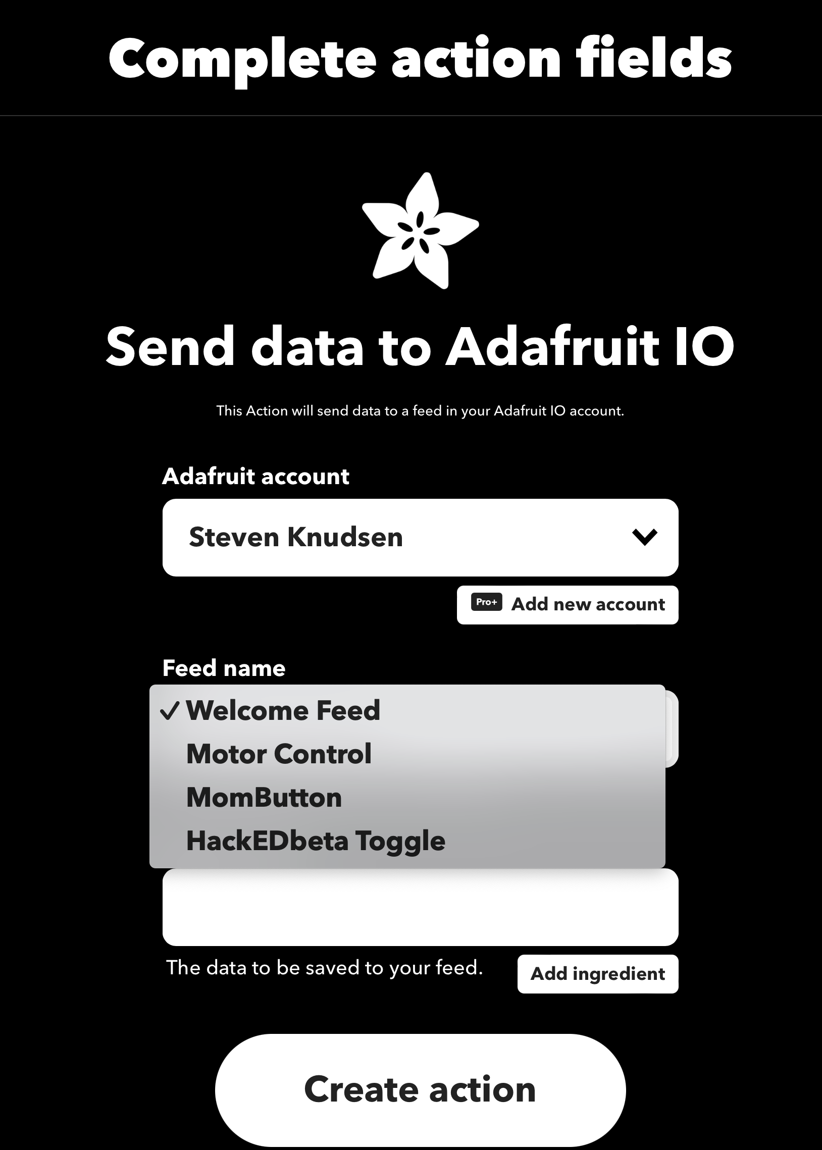
Notes:
I had already connected my Adafruit account as a service in IFTTT, so IFTTT knew about the feed names available.
We choose HackEDbeta Toggle

Slide 38
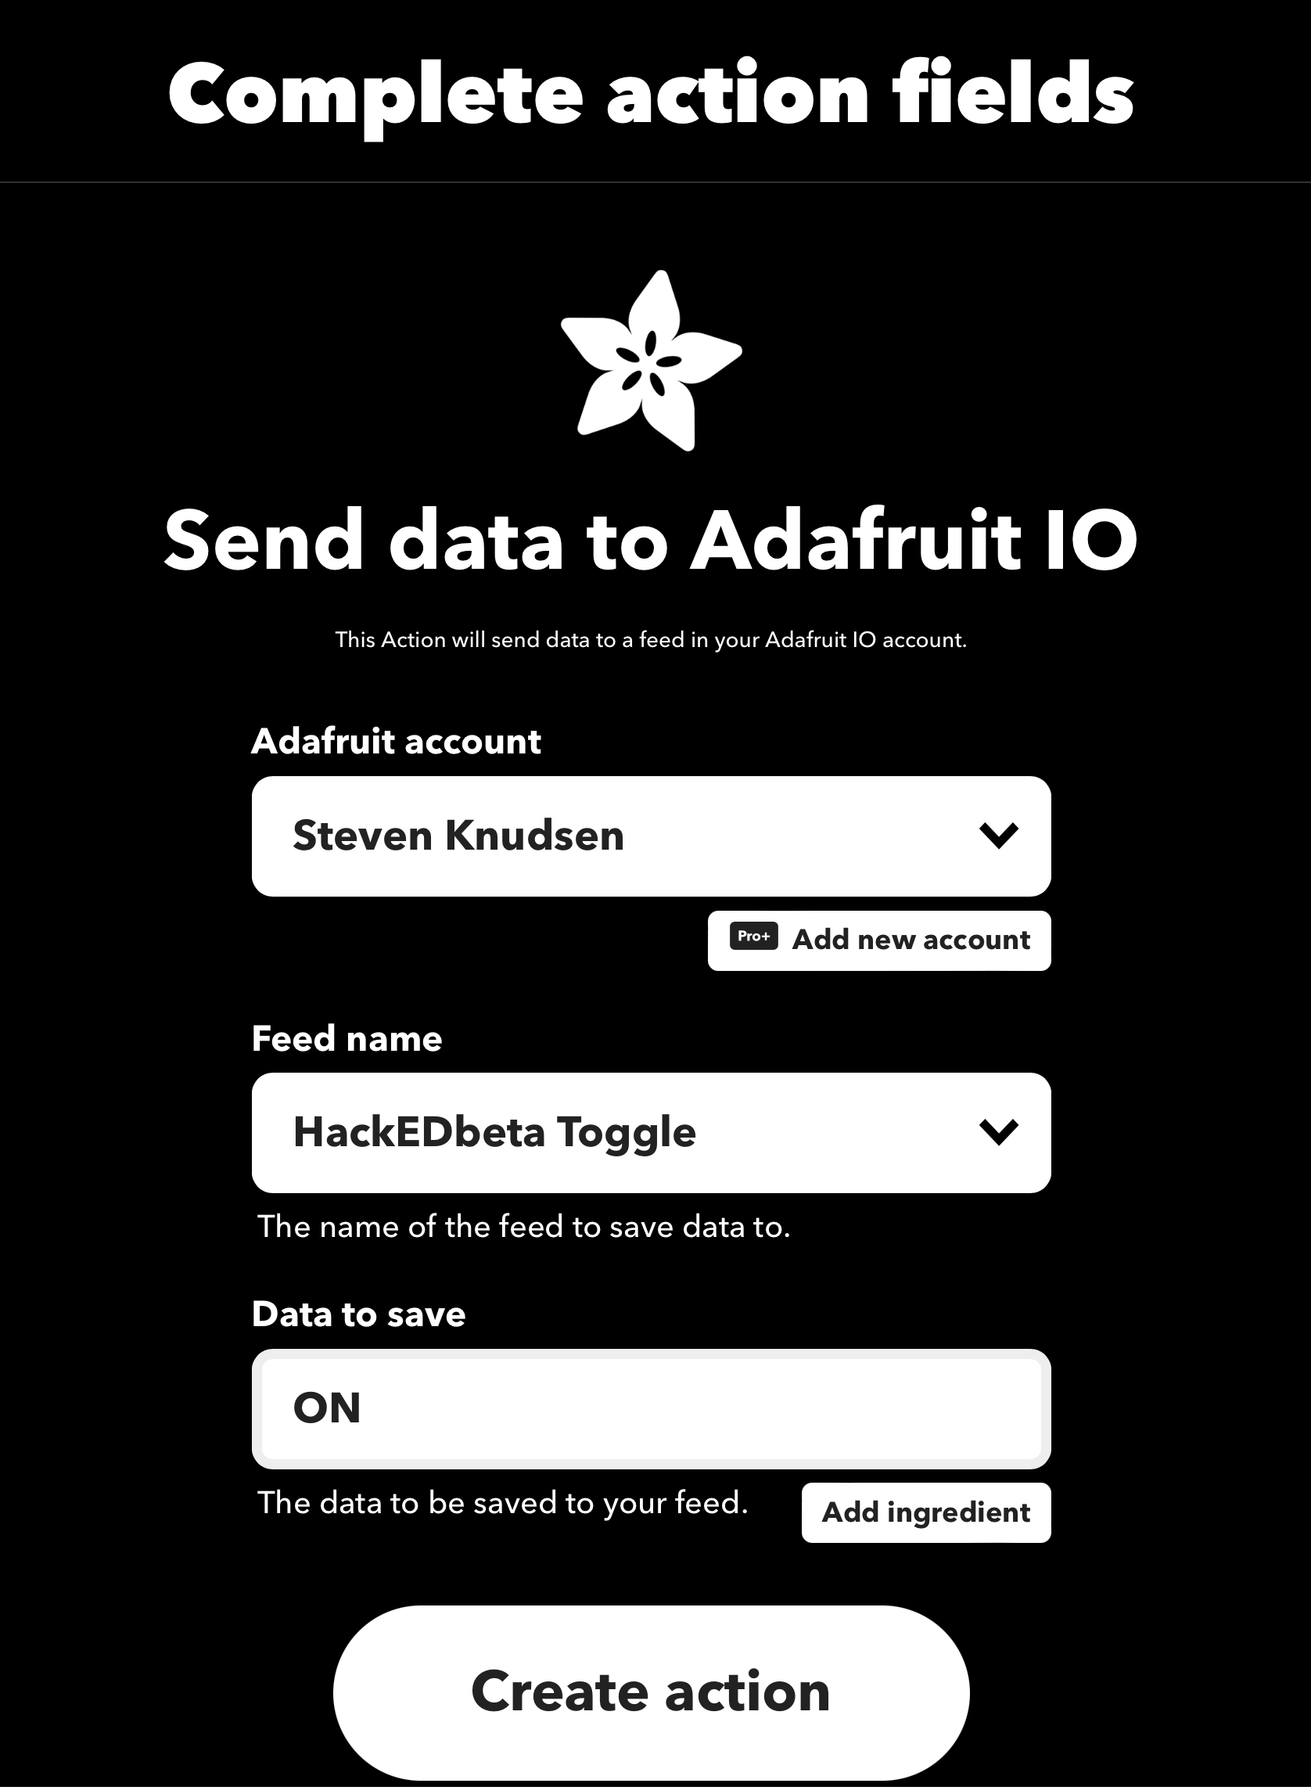
Notes:
We can put anything for the data to save, but we’d like to differentiate one button push from another so we can switch things on and off
Click Create action

Slide 39
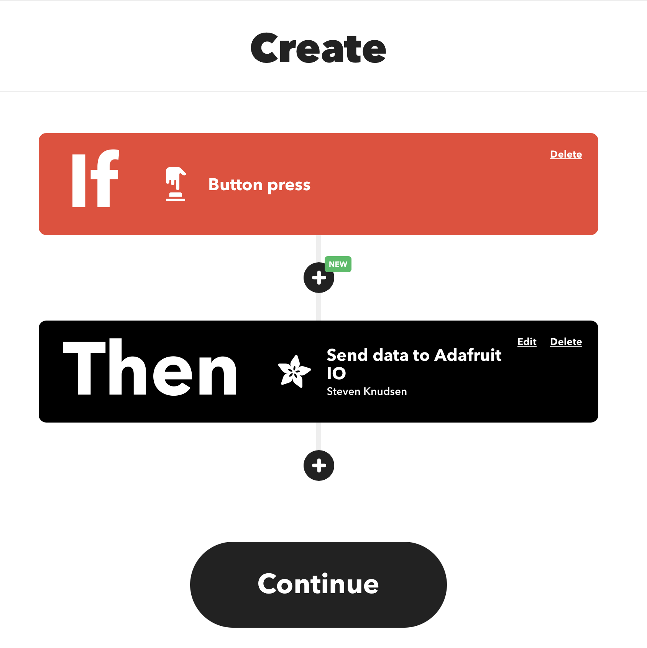
Notes:
Now we have a widget, which responds to a button press, and we have an action, which is to send some data to Adafruit IO
Continue

Slide 40
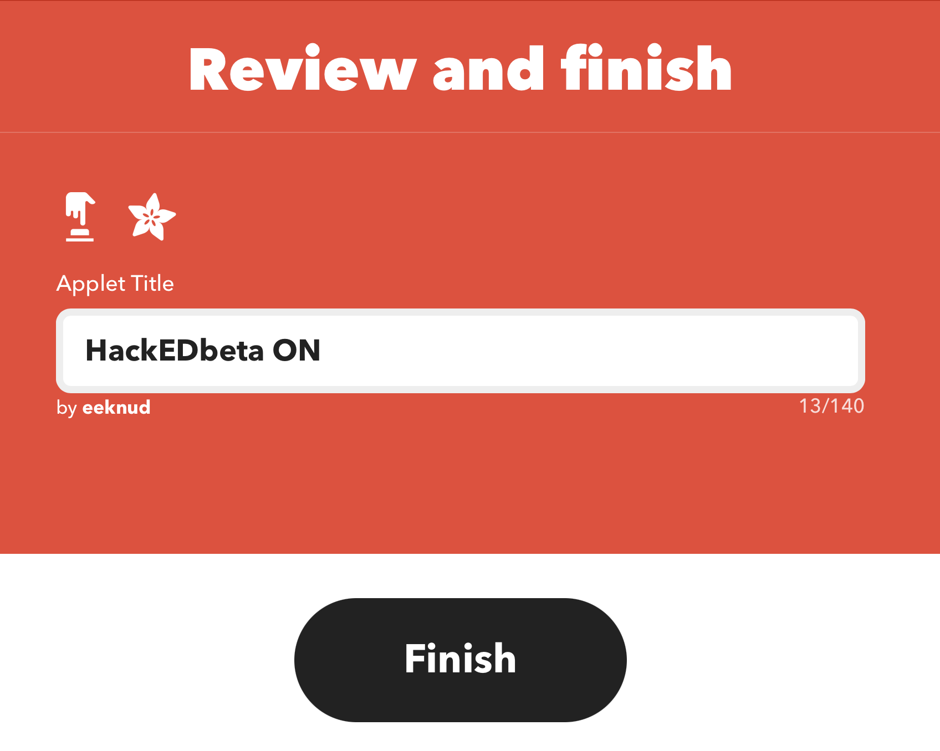
Notes:
I didn’t like the default name for the applet, so made it something better
Our widget is finished, so click Finish

Slide 41
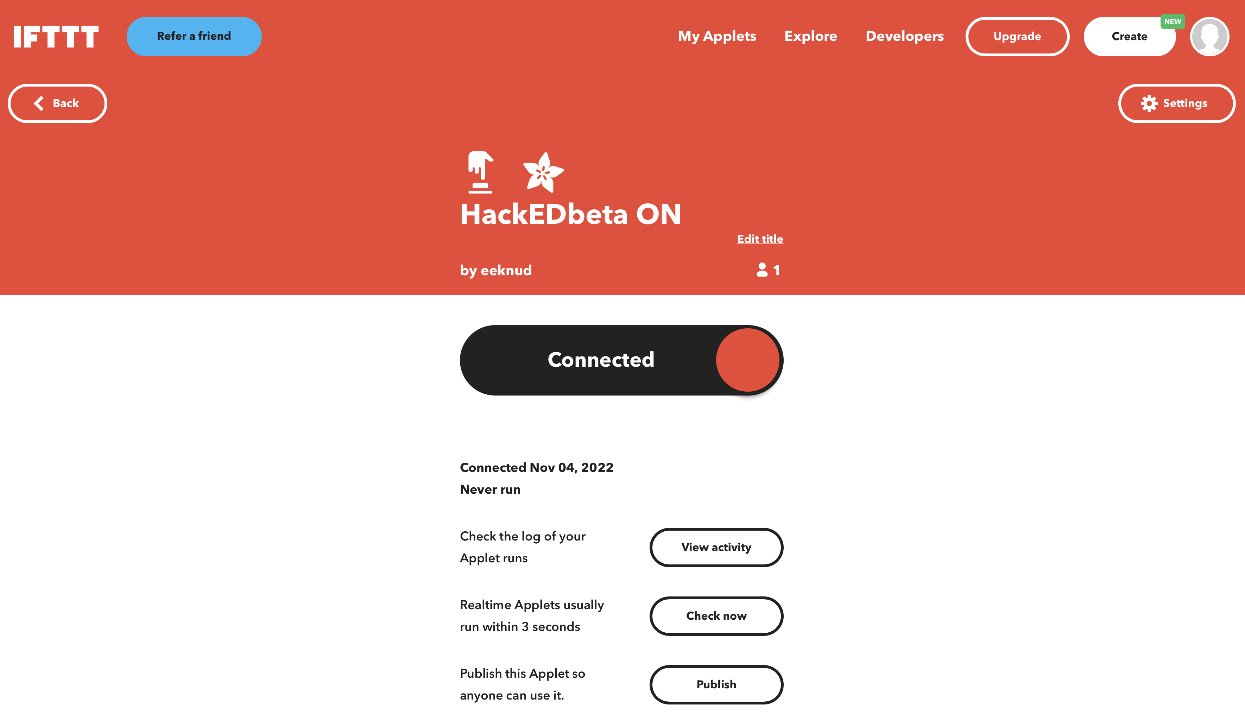
Notes:
Ta da!

Slide 42
Duplicate what we just did to make a second widget
It will be HackEDbeta OFF, and will send a message that is “OFF” when toggled

Slide 43
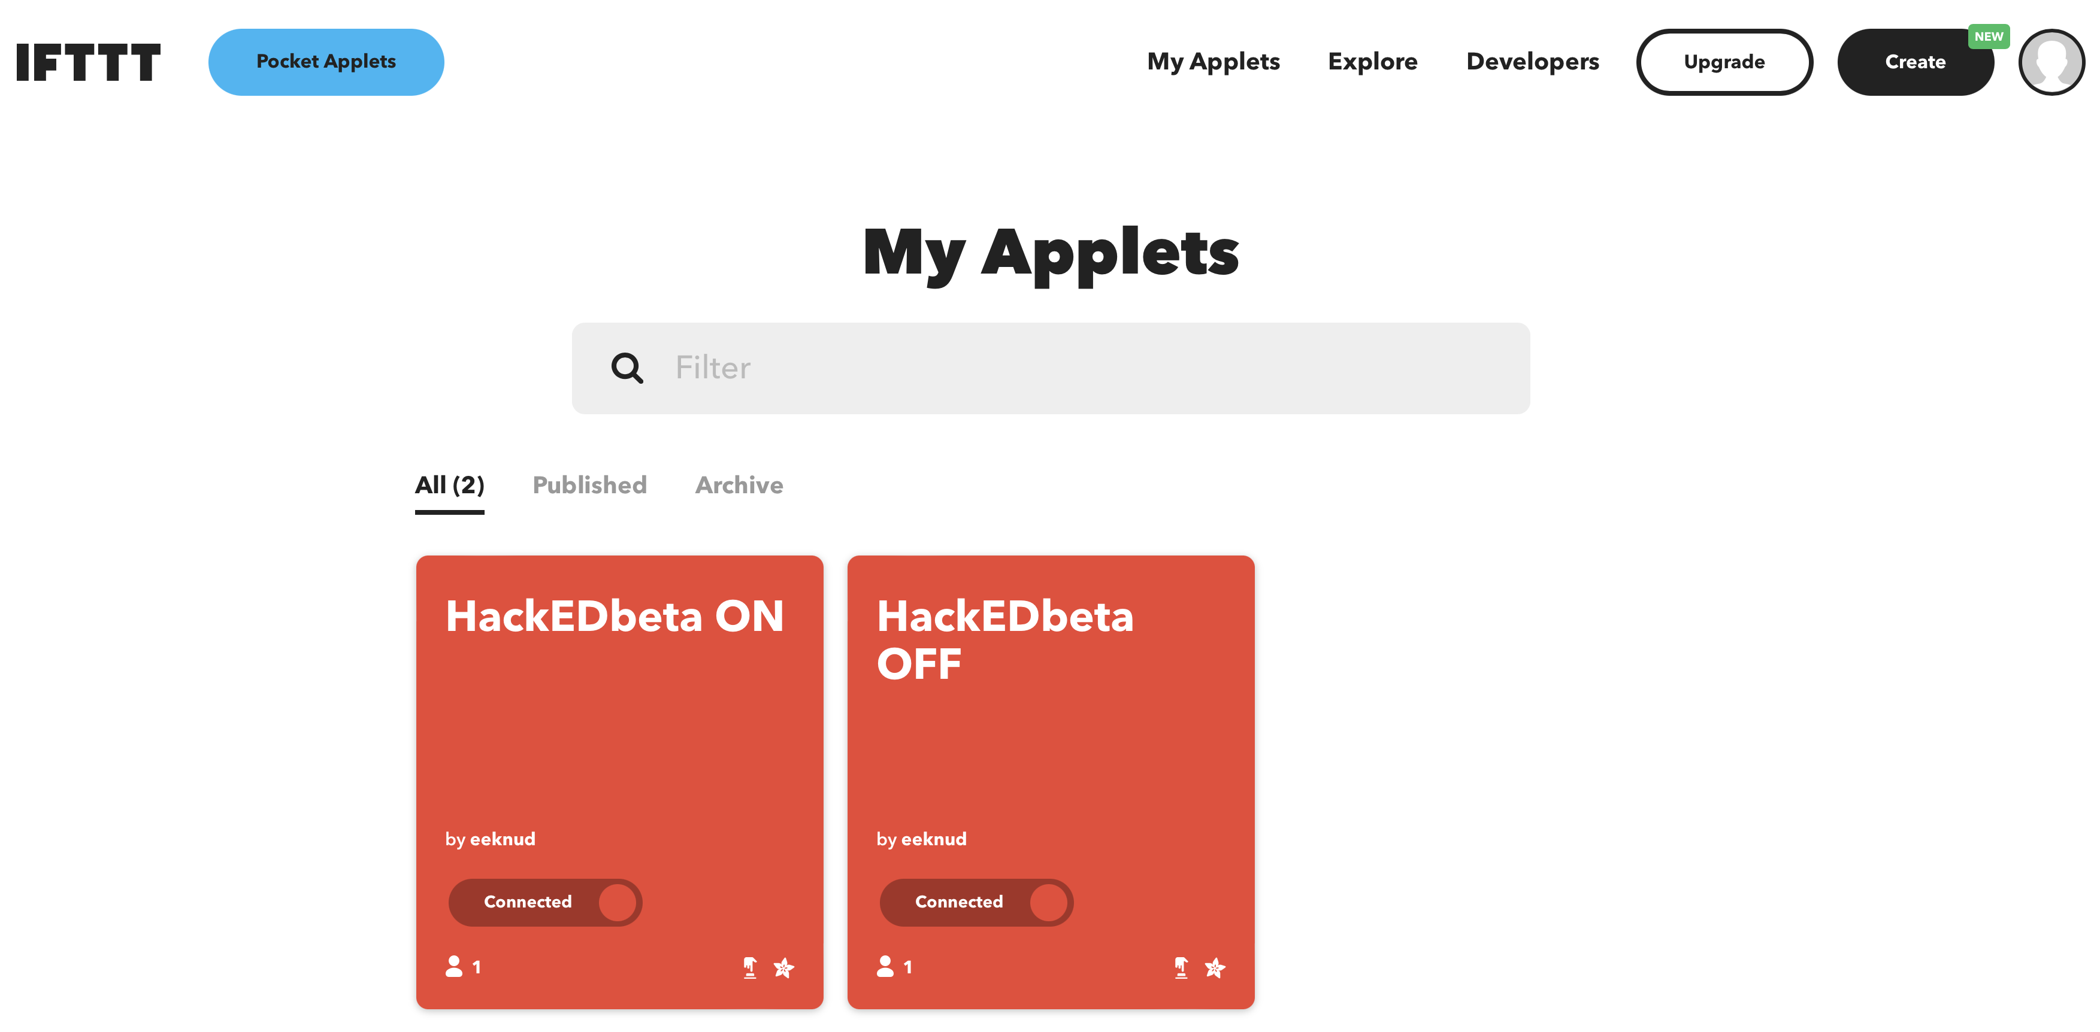
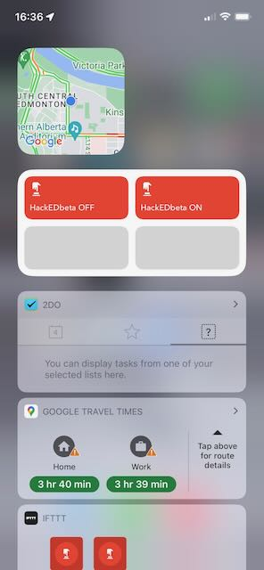
Notes:
Pretty soon the new widgets show up on my iPhone IFTTT app
If I swipe right, I can see that the widget shows up on the screen. I can tap it to send a message to the MQTT broker, essentially that I’ve pressed the momentary button
<switch to live MQTT and show action received in real time>

Slide 44
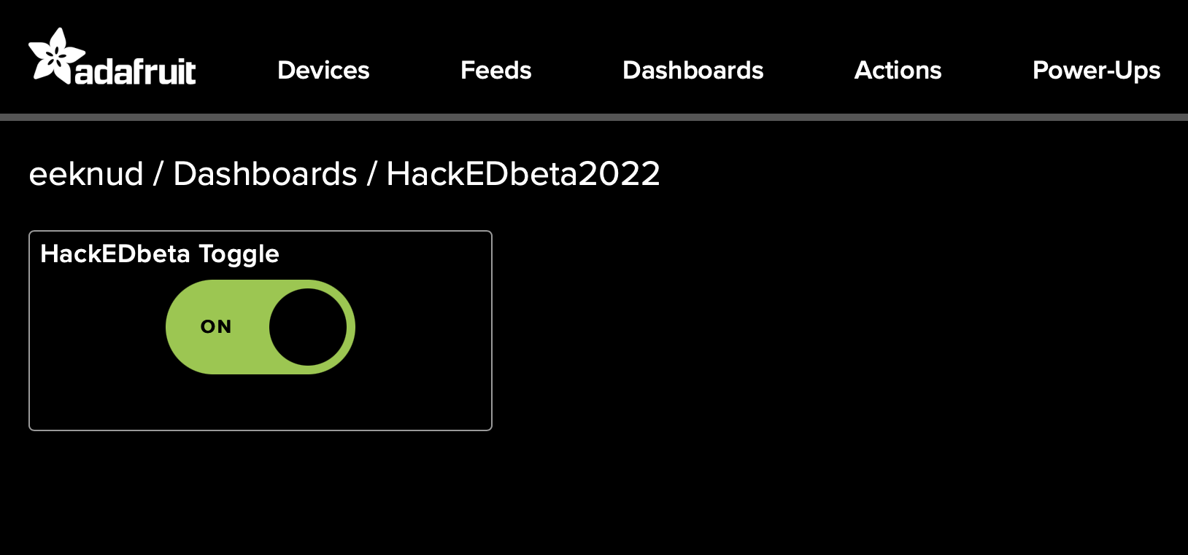

Slide 45
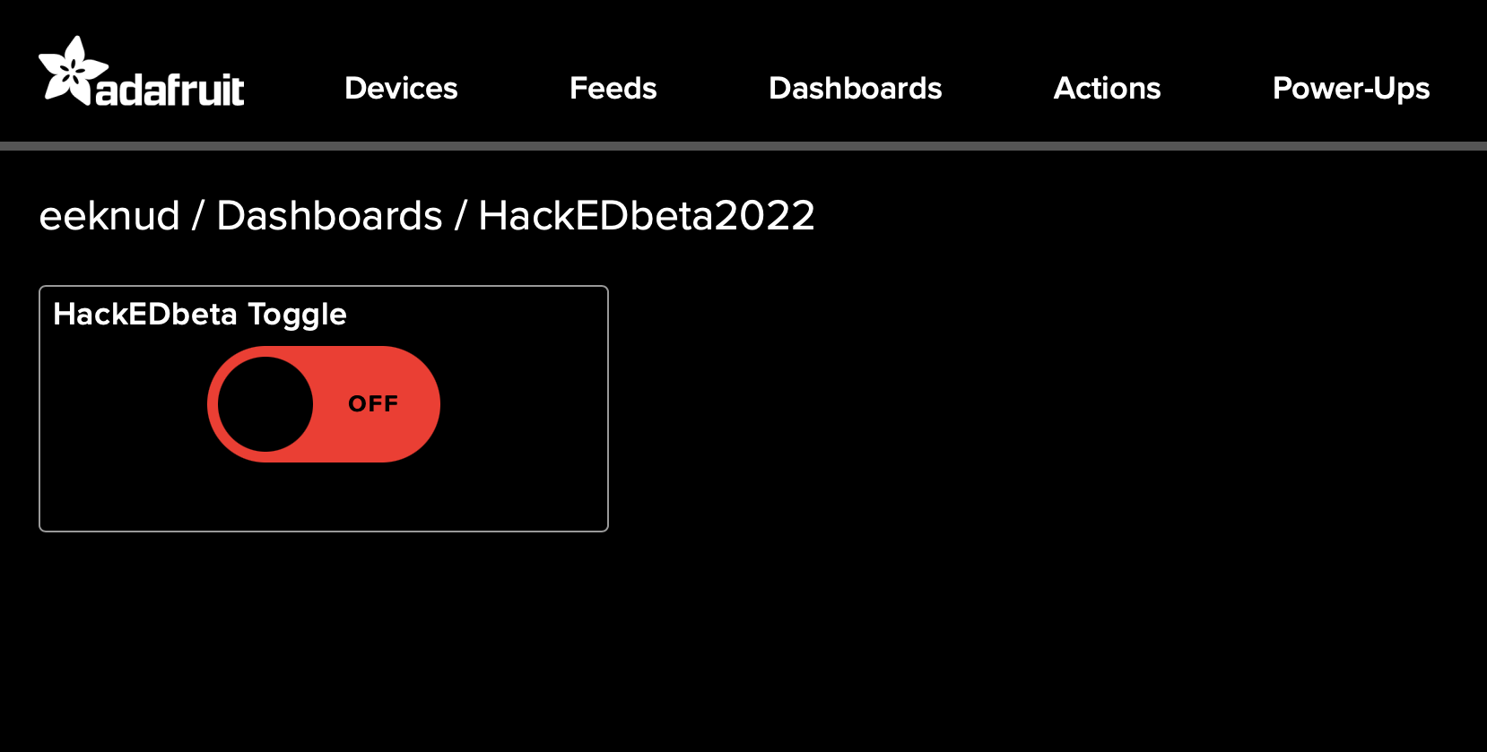

Slide 46
So far...
At this point the IFTTT ON and OFF widgets should activate and be available on your phone
BTW, you need an IFTTT account and their app
Activating the widget sends the data you specified to the Adafruit feed
The Adafruit MQTT broker makes note of it for any subscribers
But we need a subscriber...

Slide 47
Raspberry Pi
Need to be sure that requests, and adafruit-io are installed.
sudo pip3 install requests
sudo pip3 install adafruit-io
Need MQTTRelay.py from github.com/knud/HackEDbeta2022Workshop
MQTTRelay
Connects to Adafruit.io MQTT server
Looks for changes to the last posted message (ON or OFF)
Notifies the user via the command line and a simple Tkinter window

Slide 48
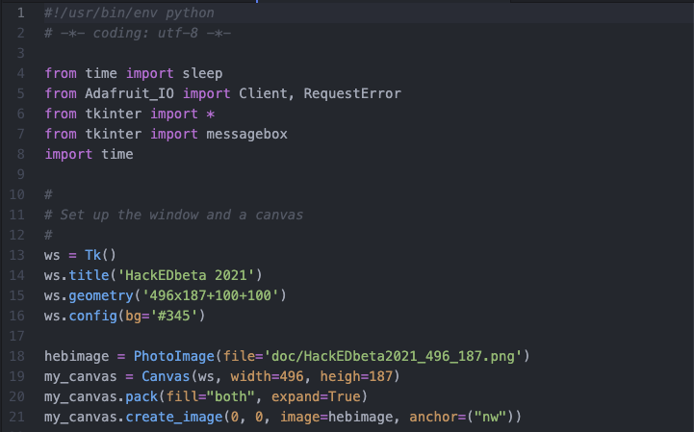
Update
Notes:
In the first part of the Python program we just import what is needed and set up the Tkinter window used to show the status of the received message
That is, the button push from the phone widgets

Slide 49
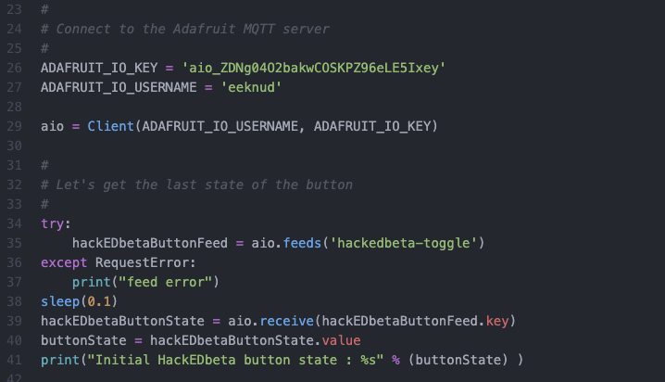
Update
Notes:
Next we define the credentials from Adafruit.io, which we saved in an earlier step
We use them to connect to Adafruit.io and get the initial stat of the button feed data

Slide 50
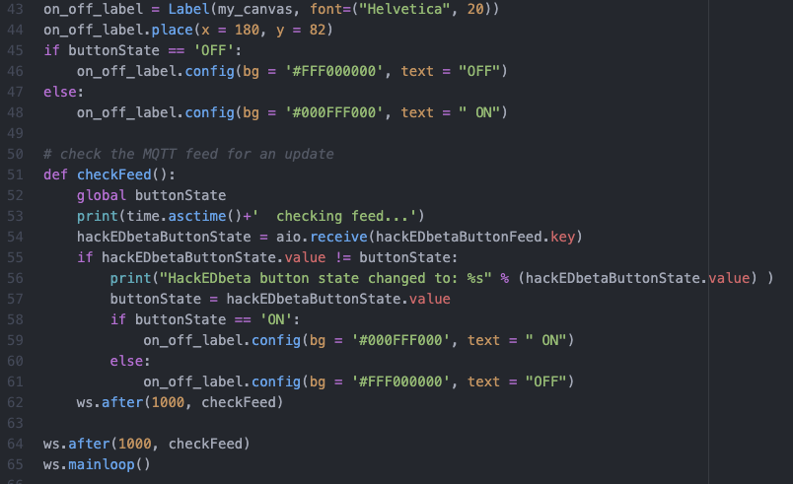
Update
Notes:
The last thing we do is to define a simple Tkinter label we can use to show the change in button state
It will show either ON or OFF.
The checkFeed task is used to check the state of the feed every second, as can be seen in the “after” function.

Slide 51
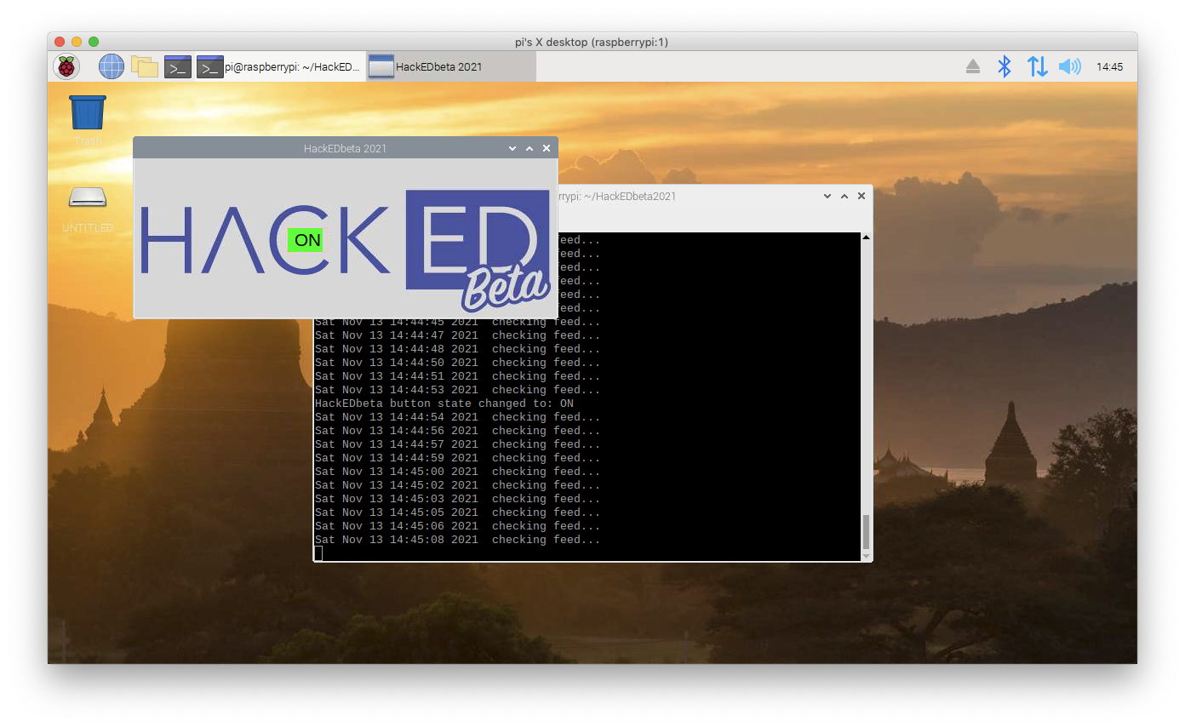
Update
Notes:
When we run the MQTTRelay.py program from the command line, we’ll see something like this.
Let’ try and do a live run

Slide 52
Objective: Tkinter notification triggered.

